Slide 1
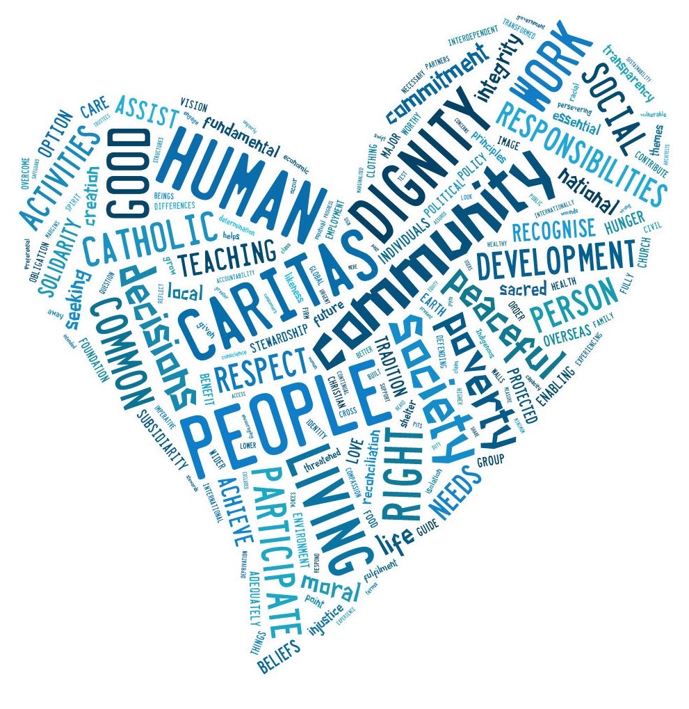

Catholic Social Teaching Prayer
Created with tagxedo.com
Notes:
Word cloud produced with tagxedo.com

Slide 2
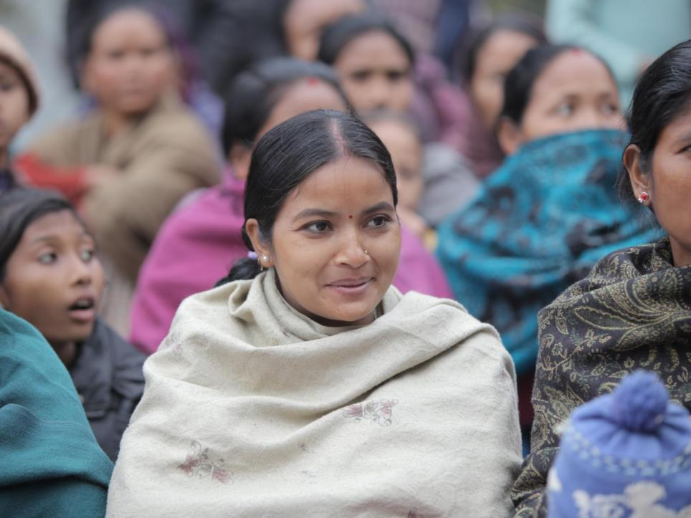

WE BELIEVE
IN THE DIGNITY OF THE HUMAN PERSON
Photo credit: Stephen Kadlec / Caritas Australia

Slide 3
Reader:
Loving God,
We believe that every person is created in your image and this makes us all very special. May we always work to end poverty and make things fair so all people can live a full and beautiful life.
ALL:
Lord hear our prayer.

Slide 4
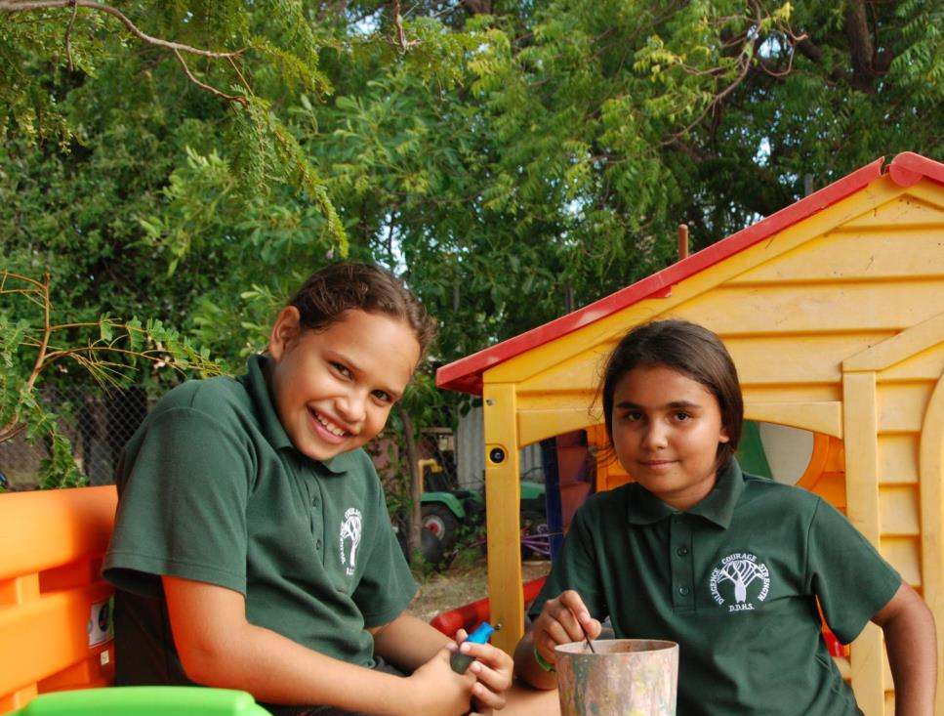

WE BELIEVE
IN THE PREFERENTIAL OPTION FOR THE POOR
Photo credit: Maya Haviland / Caritas Australia

Slide 5
Reader:
Loving God,
May we always help other people who do not have what they need such as food, clean water and a home. Help us see what causes people to live in poverty, and what we can do to make a difference.
Lord hear us.
ALL:
Lord hear our prayer.

Slide 6
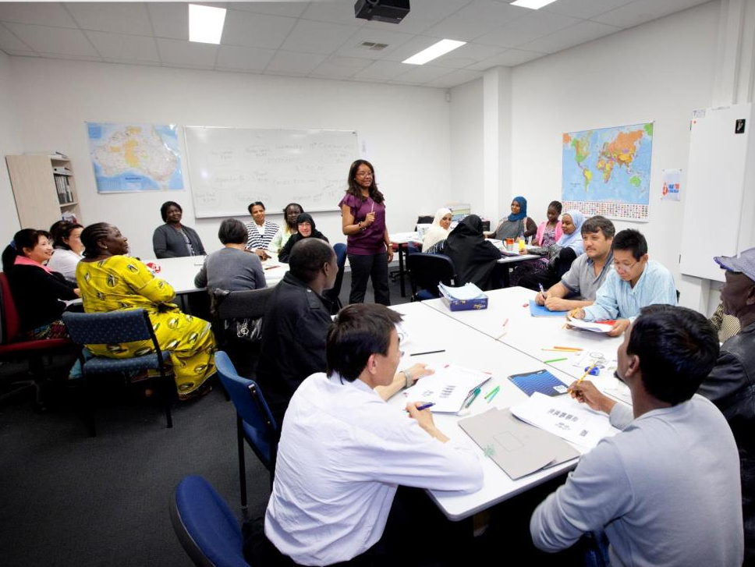
WE BELIEVE
IN PARTICIPATION
Photo credit: LifeLink

Slide 7
Reader:
Loving God,
May all people have a say in the decisions that impact their own lives. You have given us many talents. May we use these to create a just and peaceful world where no one lives in poverty.
Lord hear us.
ALL:
Lord hear our prayer.

Slide 8
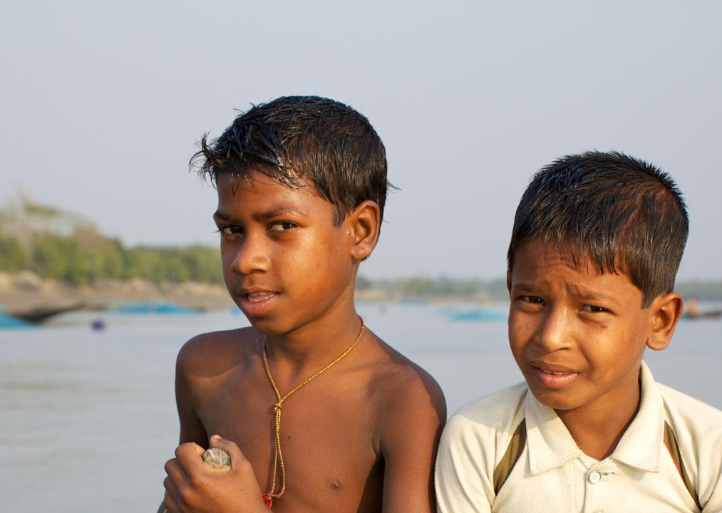
WE BELIEVE
IN SOLIDARITY
Photo credit: Richard Wainwright/Caritas Australia

Slide 9
Reader:
Loving God,
Help us see each other as members of one global human family, all equal in your eyes. May we recognise the responsibilities we have to each other, and always help each other be the best they can be.
Lord hear us.
ALL:
Lord hear our prayer.

Slide 10
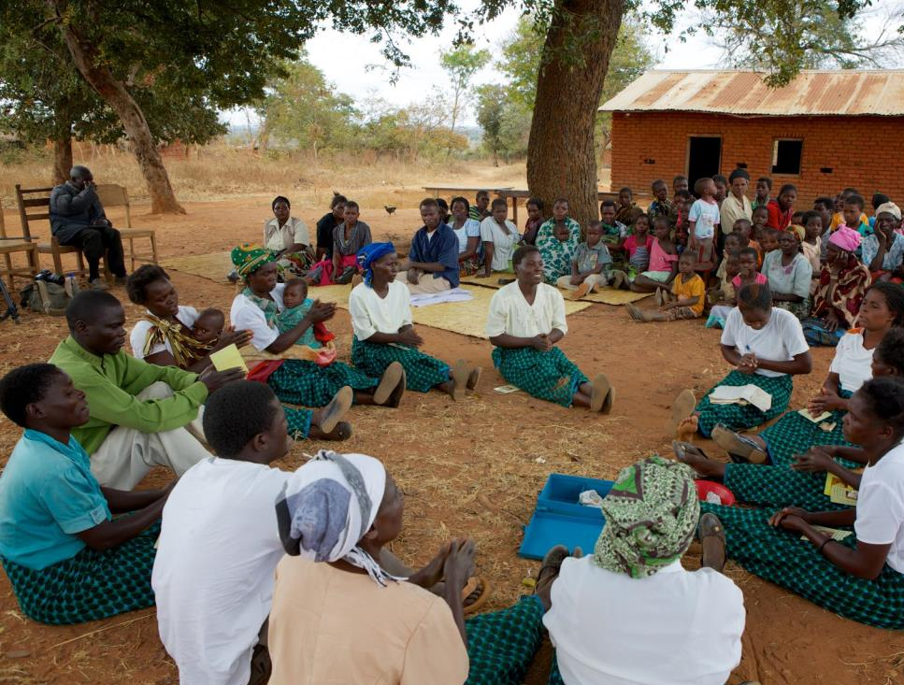
WE BELIEVE
IN THE COMMON GOOD
Photo credit: Richard Wainwright

Slide 11
Reader:
Loving God,
You help us see beyond what we need to what is good for all people. May we work towards a world where everyone has their fair share.
Lord hear us.
ALL:
Lord hear our prayer.

Slide 12
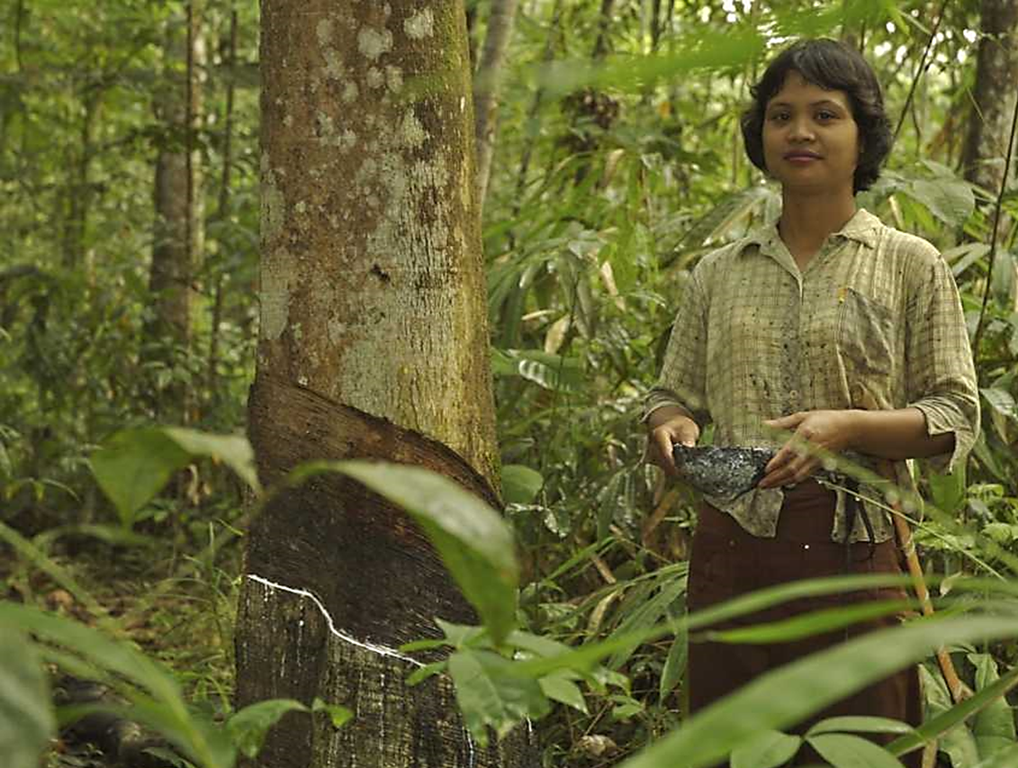
WE BELIEVE
IN STEWARDSHIP OF CREATION
Photo credit: Ramadian Bachtiar/Caritas Australia

Slide 13
Reader:
Loving God,
We thank you for your gift of our earth and all living things. May we always take good care of our environment and each other.
Lord hear us.
ALL:
Lord hear our prayer.

Slide 14
