Slide 1
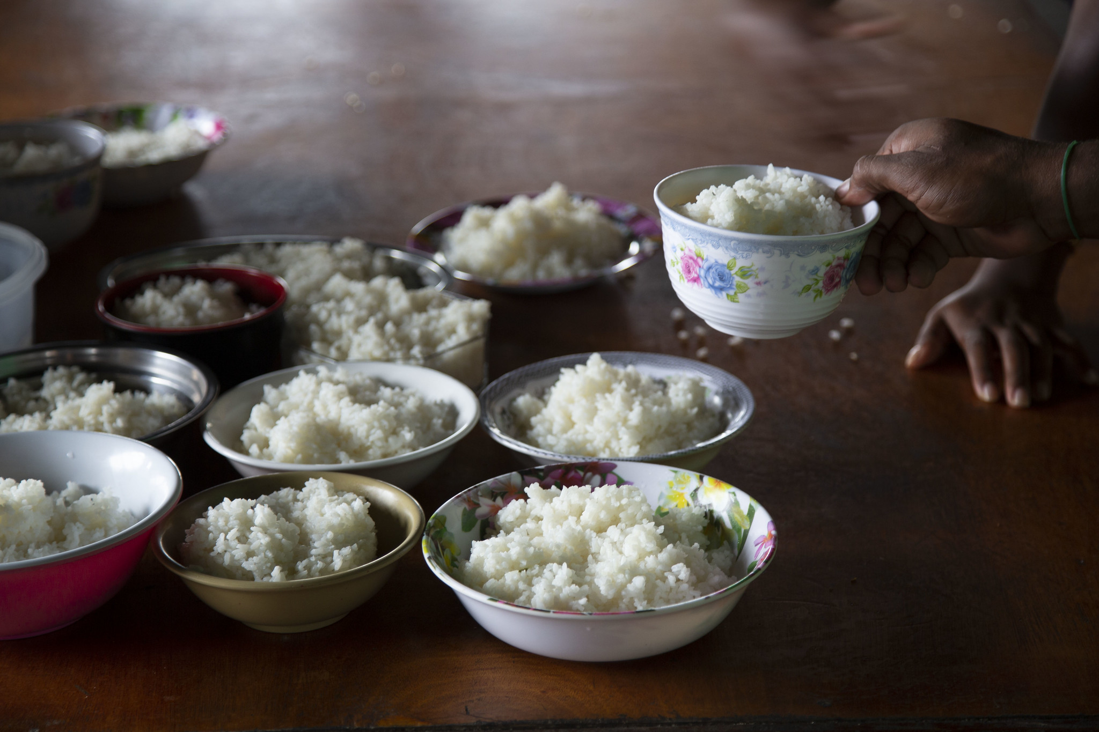
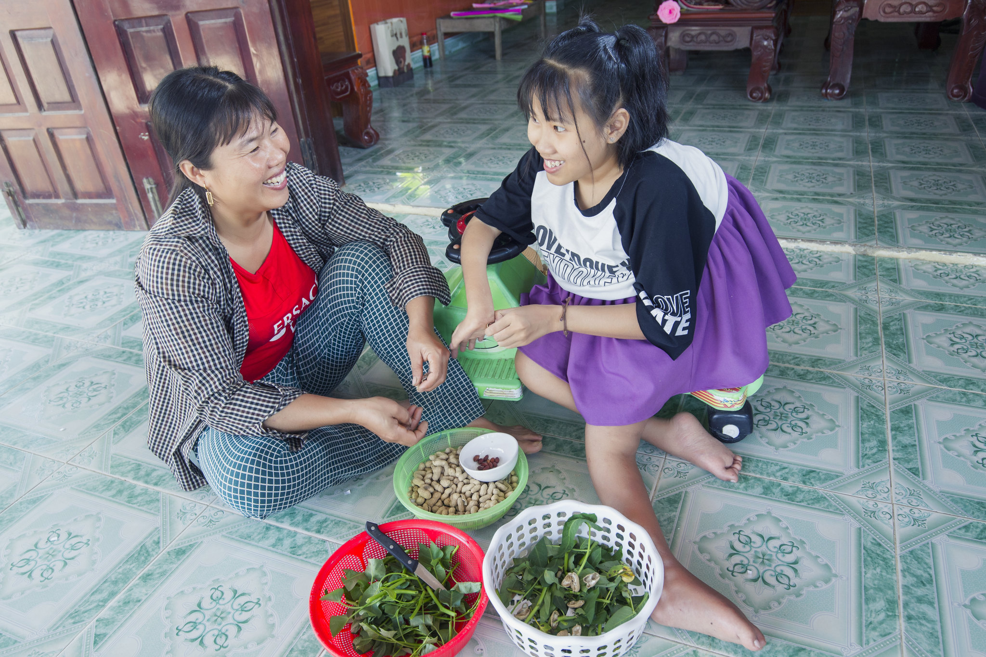
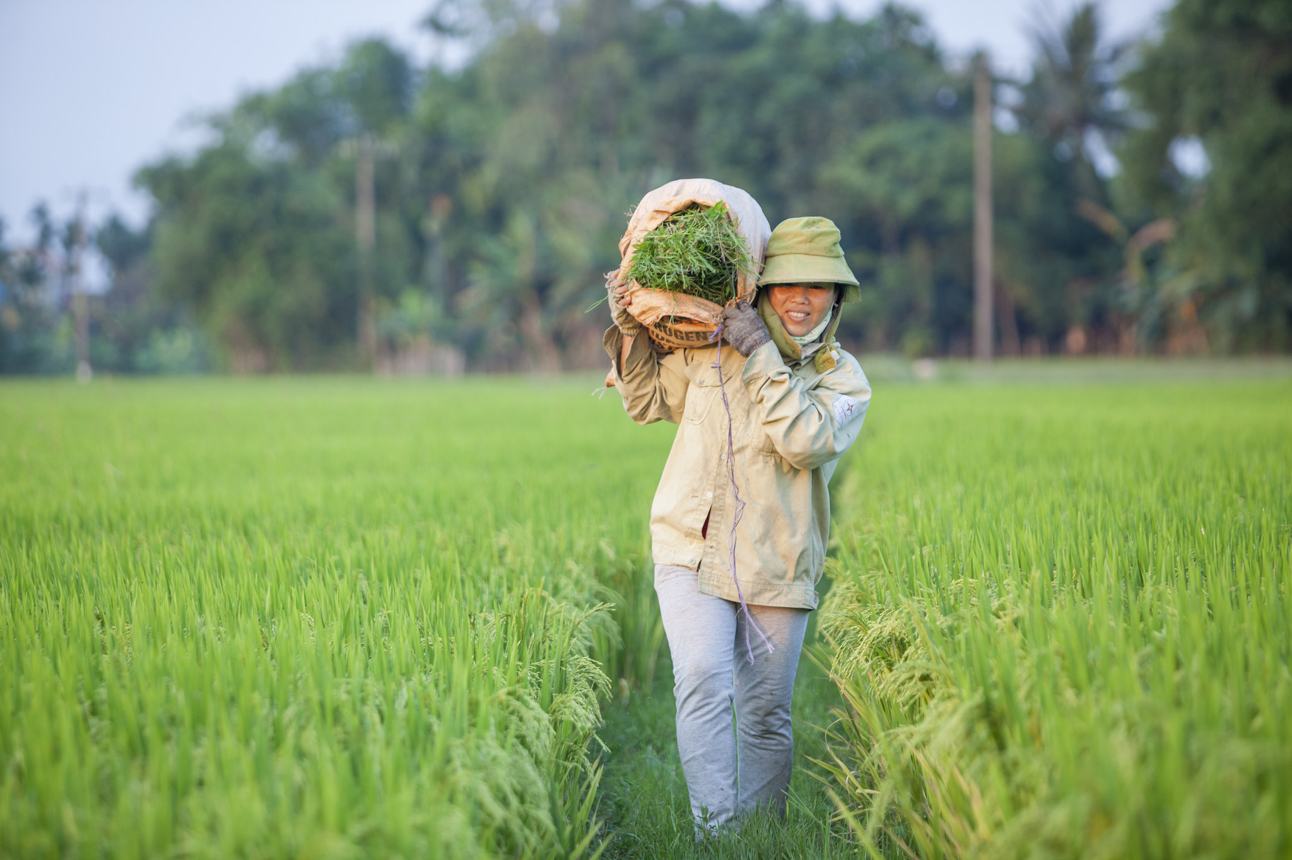
FOOD QUIZ
Last updated: October 2020

Slide 2
FOOD QUIZ
INSTRUCTIONS
Click here to play this quiz on the Kahoot interactive learning platform.
This is an interactive resource. As you go through this quiz use your mouse to click on the correct answer for each question.
If you make a mistake you can go back, click on the arrow and try again.
Click on the arrows to take you to the next question.
Good luck!
Note: If you do edit this resource please ensure content and photos remain with the appropriate credit to Caritas Australia and the photographers.
Copyright Policy: Material within our resources comes from a variety of sources and authors, including Caritas staff volunteers, overseas partners and news organisations. Our resources and the information, names, images, pictures, logos are provided “as is”, without warranty. Any mistakes brought to the attention of Caritas Australia will be corrected as soon as possible. To review the full Caritas Copyright Policy, please visit: Caritas Australia​

Slide 3
FOOD QUIZ
QUESTION 1
There is enough food grown to feed the world’s population.
A. True
B. False
Kitchen at school in Malaita, Solomon Islands. 'Water is life' and used in many facets of daily life. Photo credit: Cassandra Hill

Slide 4
FOOD QUIZ
FOOD QUIZ
INCORRECT.
TRY AGAIN!

Slide 5
FOOD QUIZ
QUESTION 1
A. True
CORRECT!
There is enough food grown in the world today for everyone to have the nourishment necessary for a healthy and productive life.
Kitchen at school in Malaita, Solomon Islands. 'Water is life' and used in many facets of daily life. Photo credit: Cassandra Hill

Slide 6
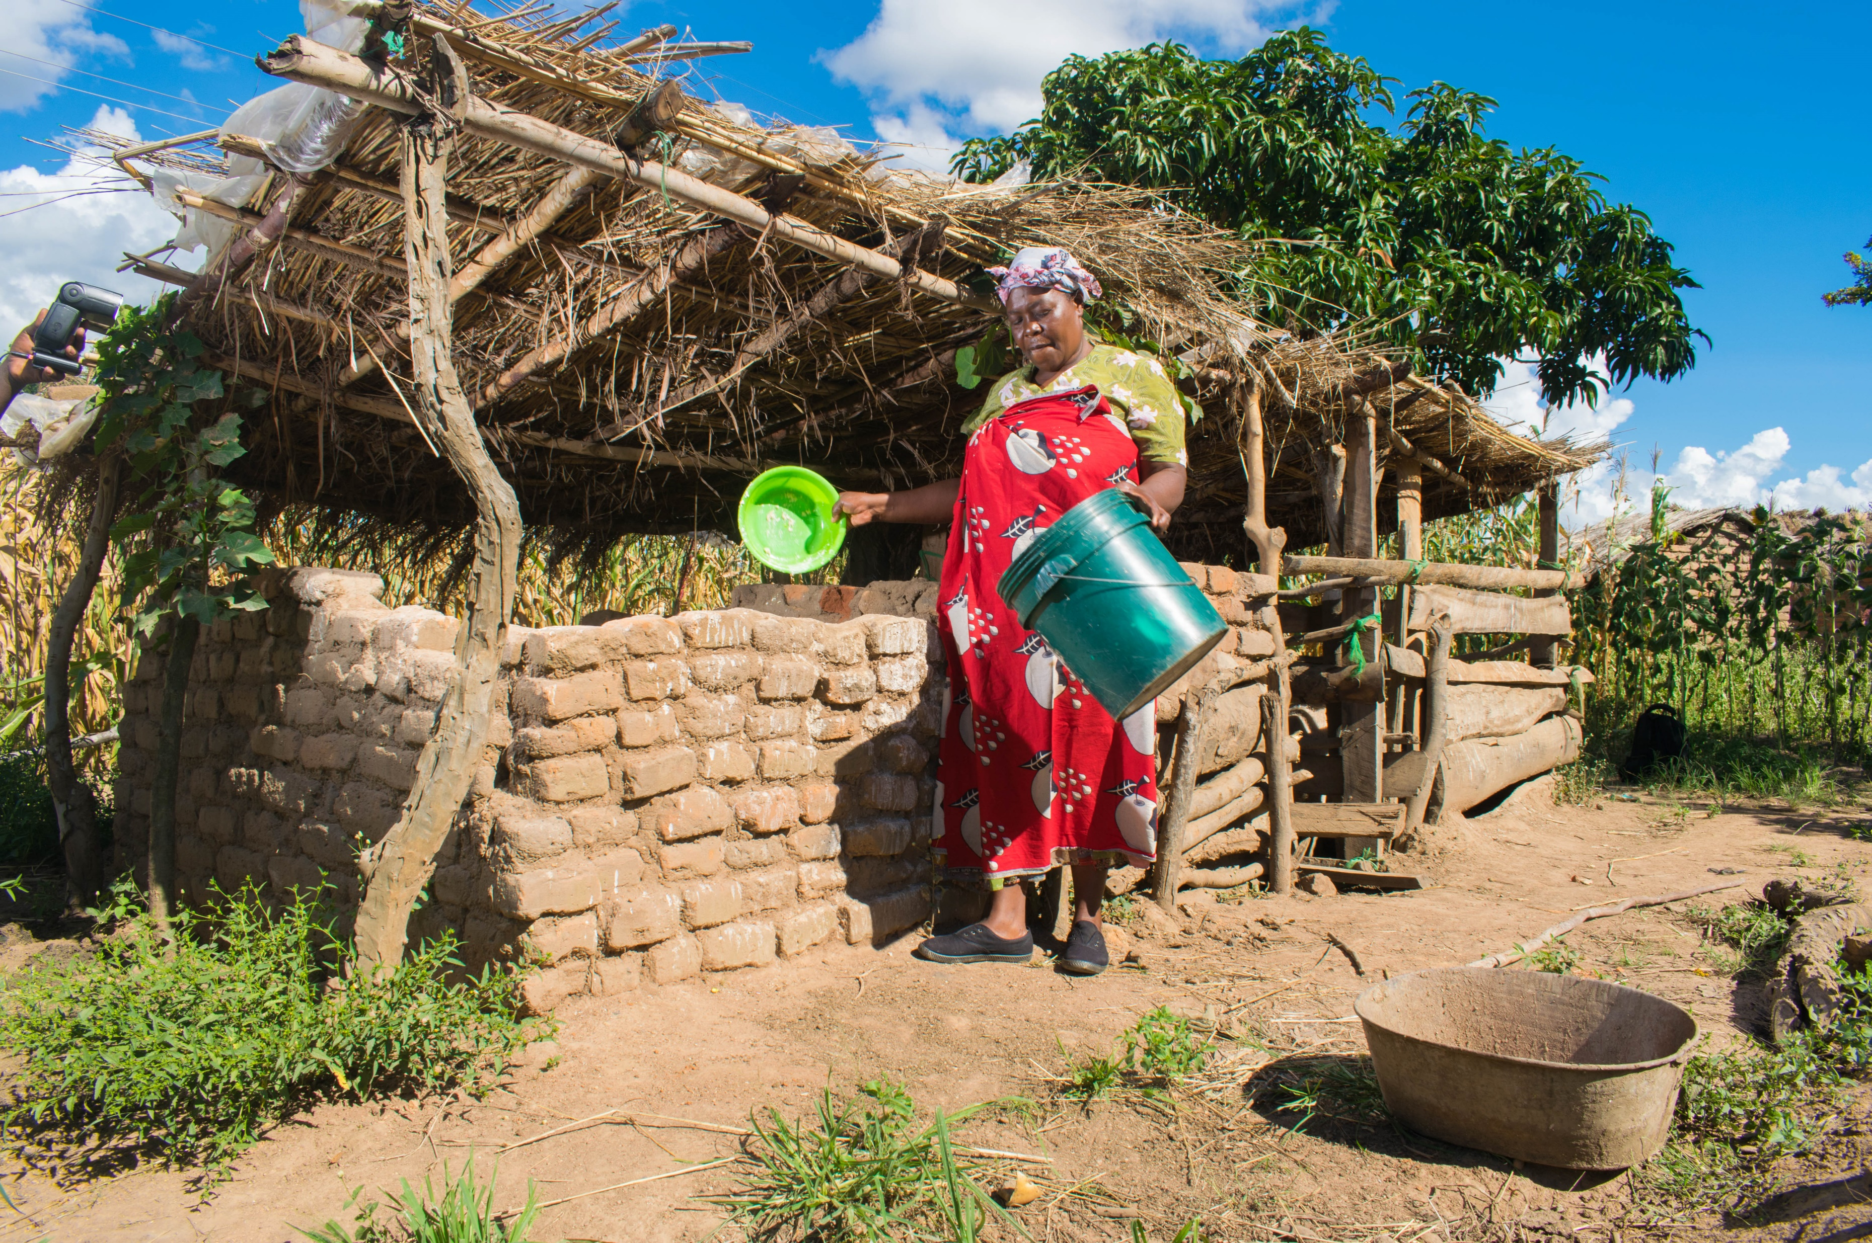
FOOD QUIZ
QUESTION 2
The number of undernourished people in the world, i.e. those facing chronic food deprivation is:
.
A. 400 million
B. 690 million
C. 550 million
Tawonga’s community banded together to develop a seed bank and dug boreholes to enable access to safe water at shorter distances to aid crop production and animal-raising. Credit: Pilirani Chimombo
Notes:
http://www.fao.org/state-of-food-security-nutrition/en/

Slide 7
FOOD QUIZ
FOOD QUIZ
INCORRECT.
TRY AGAIN!

Slide 8
FOOD QUIZ
QUESTION 2
B. 690 million
CORRECT!
Almost 690 million people in the world (8.9 percent of the world population) are estimated to have been undernourished in 2019. 10 million more than 2018 figures.
Tawonga’s community banded together to develop a seed bank and dug boreholes to enable access to safe water at shorter distances to aid crop production and animal-raising. Credit: Pilirani Chimombo
Notes:
http://www.fao.org/state-of-food-security-nutrition/en/

Slide 9
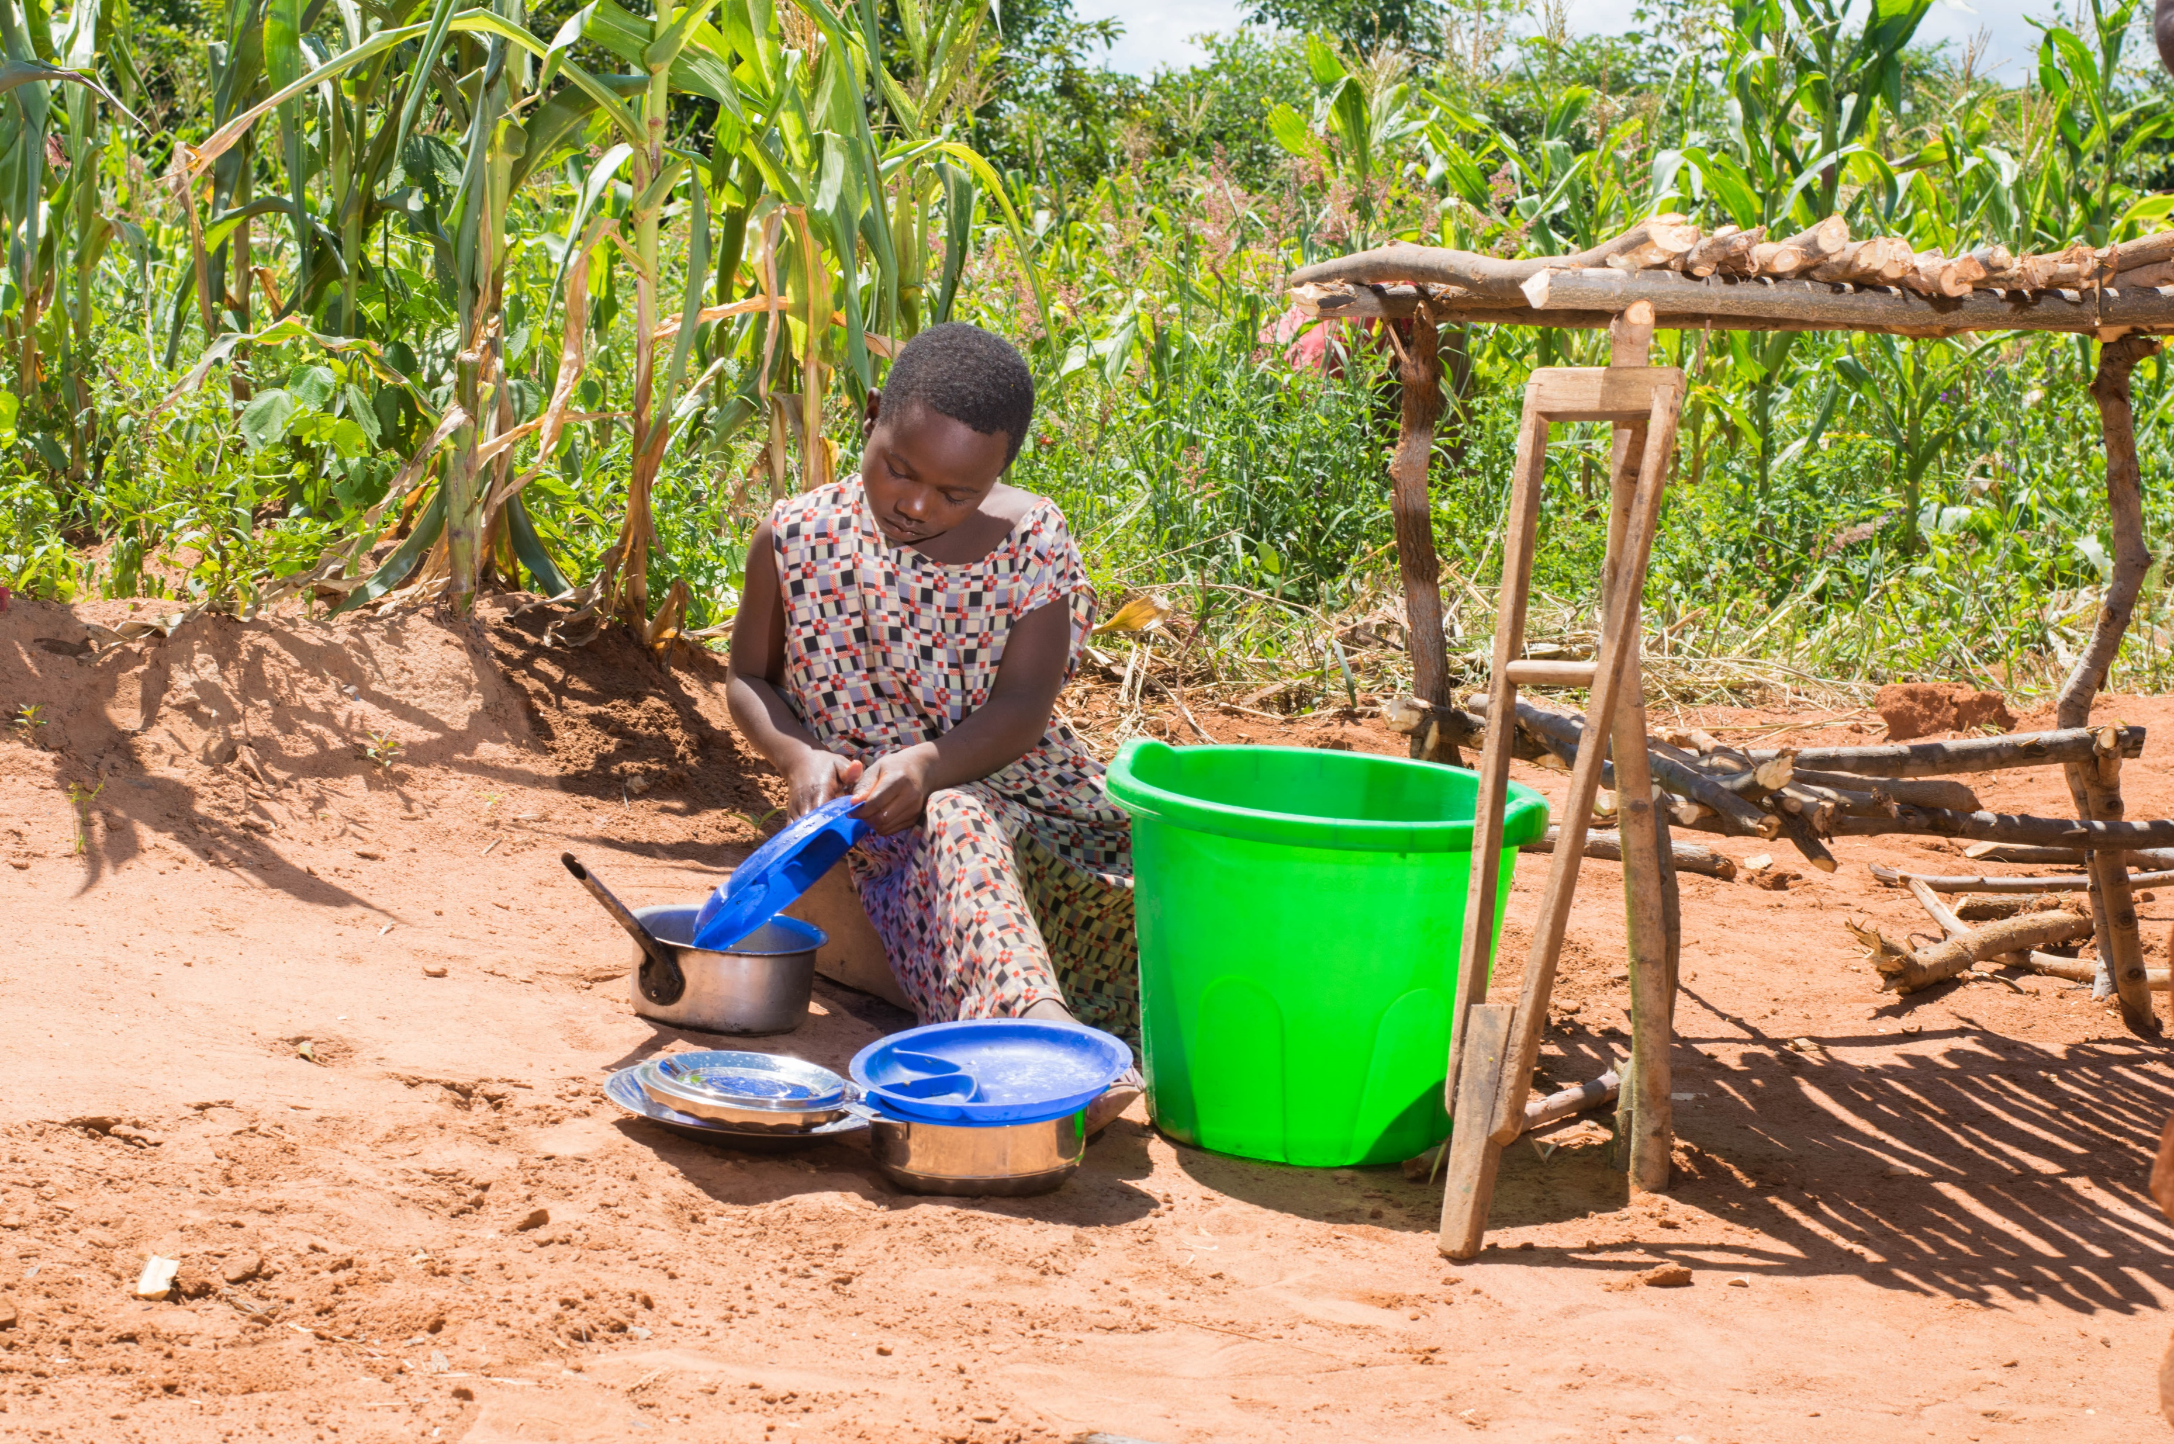
FOOD QUIZ
QUESTION 3
How many children in the world are not growing as expected for their age group, due to malnutrition, repeated infection and inadequate care?
.
A. 144 million
B. 180 million
C. 100 million
Tawonga’s community banded together to develop a seed bank and dug boreholes to enable access to safe water at shorter distances. This also led to a reduction in waterborne diseases. Credit: Pilirani Chimombo

Slide 10
FOOD QUIZ
FOOD QUIZ
INCORRECT.
TRY AGAIN!

Slide 11
FOOD QUIZ
QUESTION 3
A. 144 million
CORRECT!
In 2019, 21.3 percent (144.0 million) of children under 5 years of age were estimated to be stunted, while at least 340 million children suffered from micronutrient deficiencies.
Tawonga’s community banded together to develop a seed bank and dug boreholes to enable access to safe water at shorter distances. This also led to a reduction in waterborne diseases. Credit: Pilirani Chimombo
Notes:
Stunting Stunting is the impaired growth and development that children experience from poor nutrition, repeated infection, and inadequate psychosocial stimulation. Children are defined as stunted if their height-for-age is more than two standard deviations below the WHO Child Growth Standards median.
Stunting in early life -- particularly in the first 1000 days from conception until the age of two - impaired growth has adverse functional consequences on the child. Some of those consequences include poor cognition and educational performance, low adult wages, lost productivity and, when accompanied by excessive weight gain later in childhood, an increased risk of nutrition-related chronic diseases in adult life.
https://www.who.int/nutrition/healthygrowthproj_stunted_videos/en/
http://www.fao.org/state-of-food-security-nutrition/en/

Slide 12
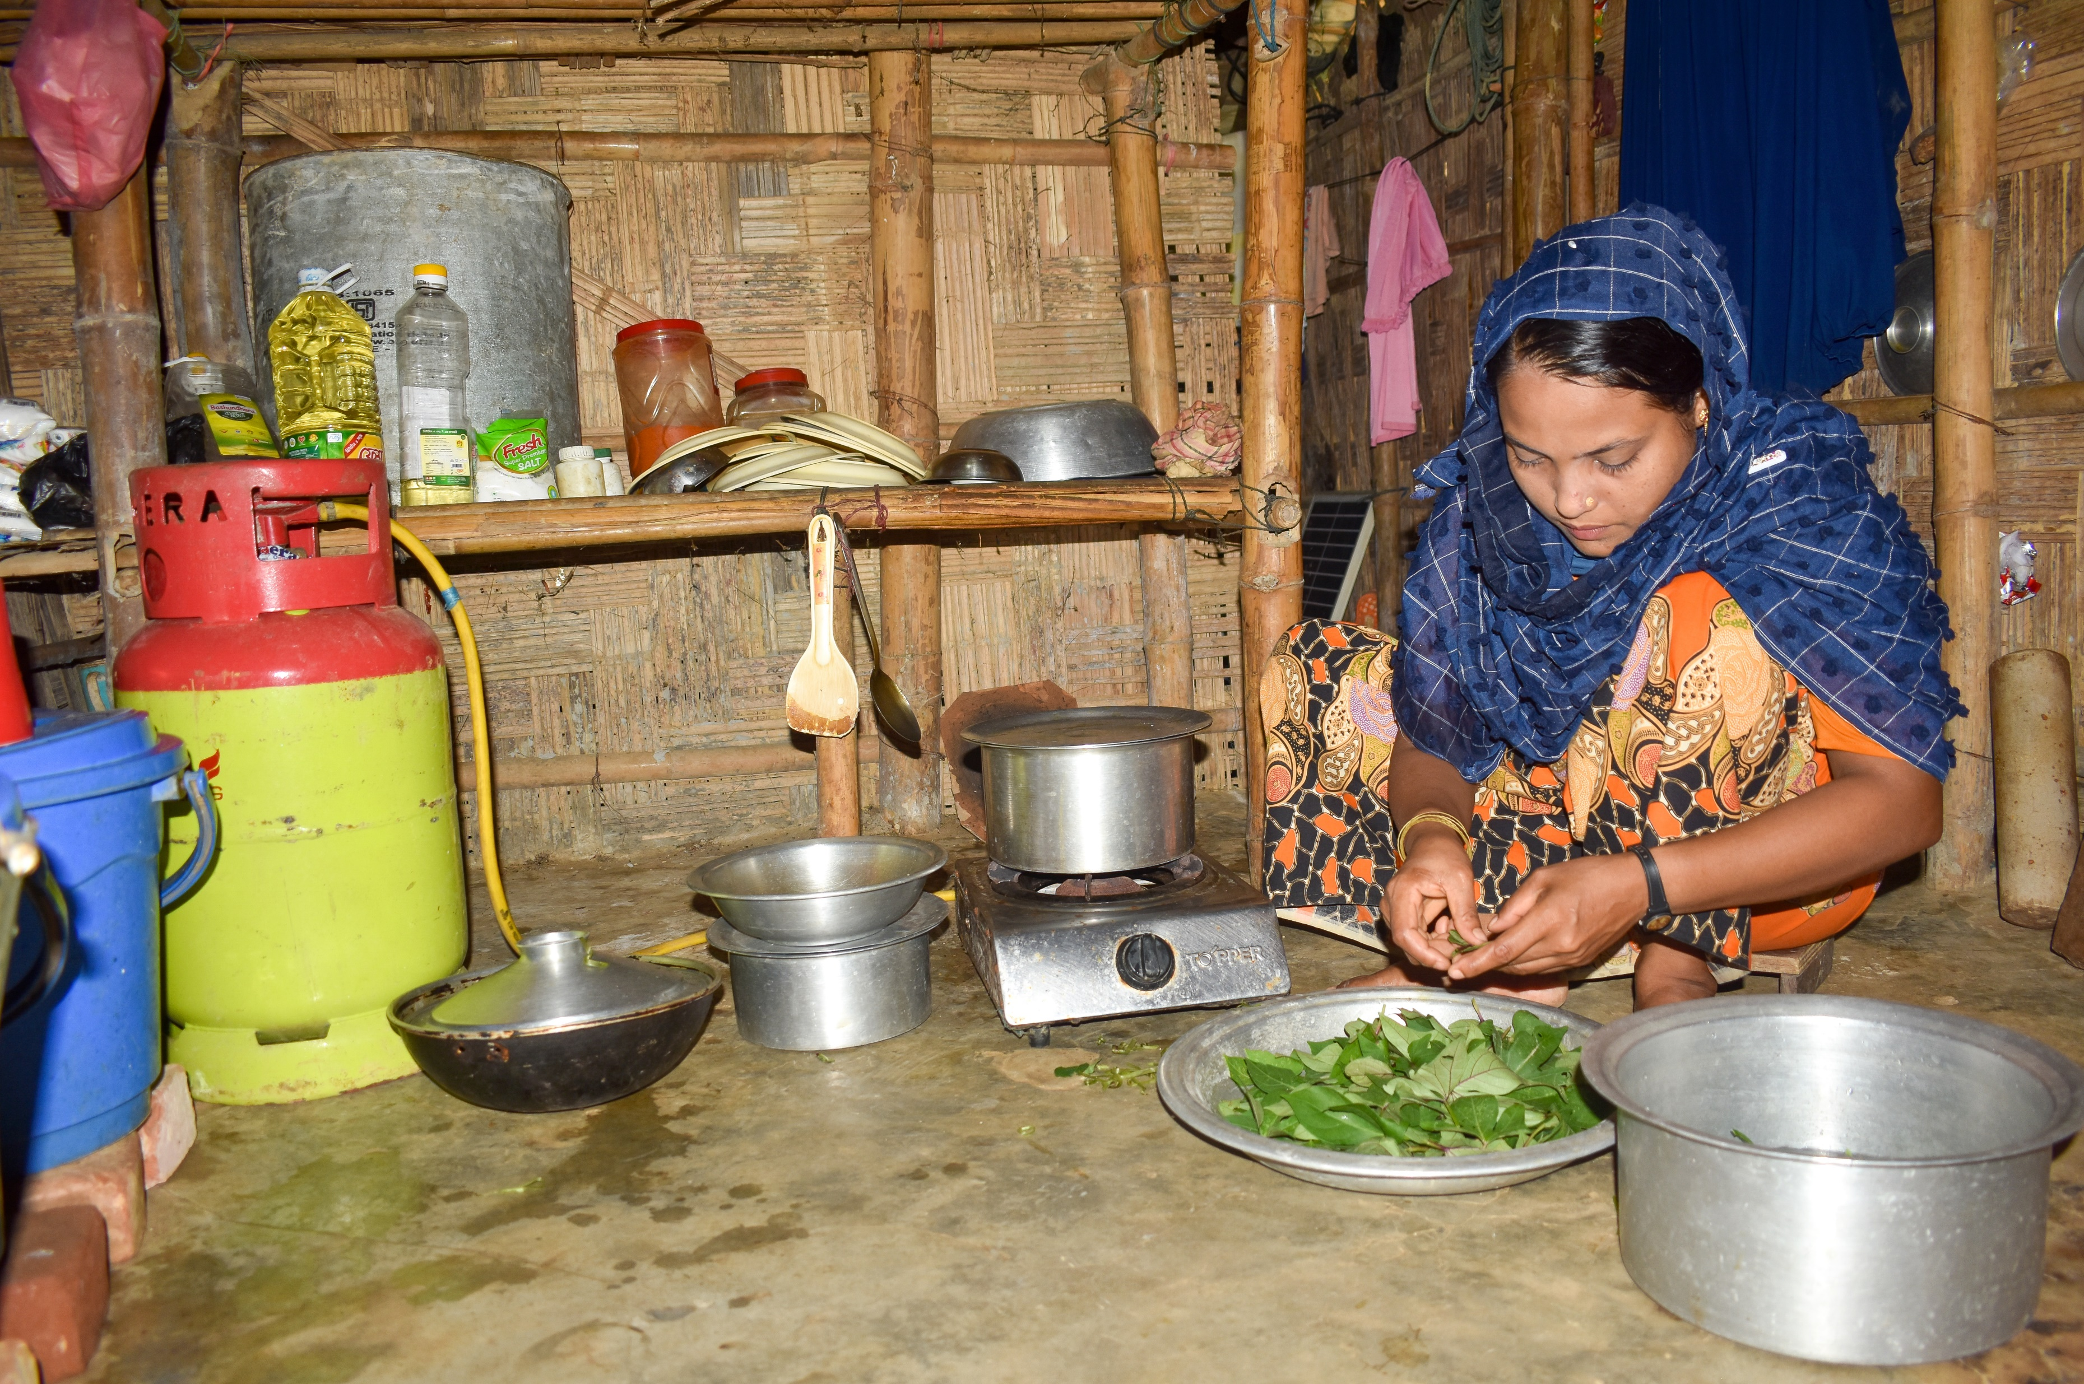
FOOD QUIZ
QUESTION 4
How much food is wasted in Australia every year?
A. 40%
B. 10%
C. 20%
Halima cooks using a Caritas donated LPG gas stove in her shelter in a Rohingya refugee camp in Bangladesh. Photo Credit: Inmanuel Biswas/Caritas Bangladesh
Notes:
http://www.foodwise.com.au/foodwaste/food-waste-fast-facts/

Slide 13
FOOD QUIZ
FOOD QUIZ
INCORRECT.
TRY AGAIN!

Slide 14
FOOD QUIZ
QUESTION 4
C. 20%
CORRECT!
This equates to 1 out of every 5 grocery bags we buy.
For the average Australian household, $1036.00 of food is thrown away each year.
If you add up all the food that Australia wastes each year, it is enough to fill 450 000 garbage trucks.
Halima cooks using a Caritas donated LPG gas stove in her shelter in a Rohingya refugee camp in Bangladesh. Photo Credit: Inmanuel Biswas/Caritas Bangladesh
Notes:
Australians throw out $8 billion worth of edible food every year.
Australians waste 4 000 000 tonnes of food each year.
Why do we waste food?
We don’t know how to use leftovers.
We cook too much food.
We don’t check the cupboard or fridge before going shopping.
Buying takeaway food rather than cooking the food we already purchased at home.
The hidden impact: when you throw out food, you also waste the water, fuel and resources it took to get the food from the paddock to your plate.
http://www.foodwise.com.au/foodwaste/food-waste-fast-facts/

Slide 15
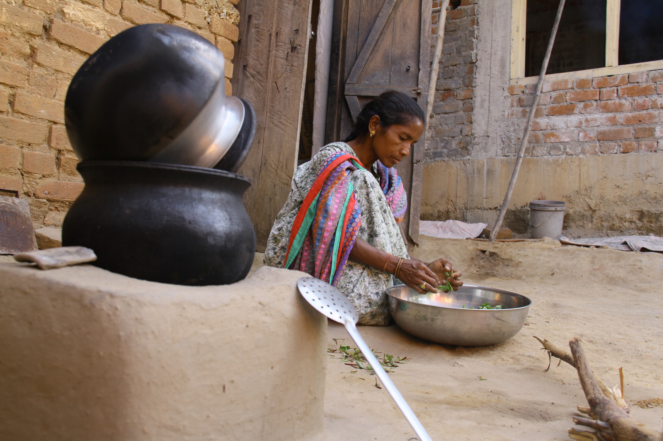
FOOD QUIZ
QUESTION 5
What is the single biggest cause of hunger?
A. Climate change
B. Poverty
C. Natural disasters
People in Sakun’s community in rural India have an improved diet due to Caritas’ support through agricultural innovations, such as collective farming and growing nutritional which improves the overall health of the community.
Credit: Patrick Hansda

Slide 16
FOOD QUIZ
FOOD QUIZ
INCORRECT.
TRY AGAIN!

Slide 17
FOOD QUIZ
QUESTION 5
B. Poverty
CORRECT!
People who are living in poverty often don’t have enough money to buy or produce food for themselves.
The causes of poverty include lack of resources, unequal income distribution in the world and within specific countries, conflict and hunger itself.
People in Sakun’s community in rural India have an improved diet due to Caritas’ support through agricultural innovations, such as collective farming and growing nutritional which improves the overall health of the community.
Credit: Patrick Hansda
Notes:
The causes of poverty include lack of resources, unequal income distribution in the world and within specific countries, conflict and hunger itself.
https://www.worldhunger.org/world-hunger-and-poverty-facts-and-statistics/
About 1.5 million children die annually due to wasting
Wasting and bilateral oedema are severe forms of malnutrition - resulting from acute food shortages and compounded by illness. Rising food prices, food scarcity in areas of conflict, and natural disasters diminish household access to appropriate and adequate food, all of which can lead to wasting. Wasting demands emergency nutritional interventions to save lives.
https://www.who.int/news-room/facts-in-pictures/detail/nutrition

Slide 18
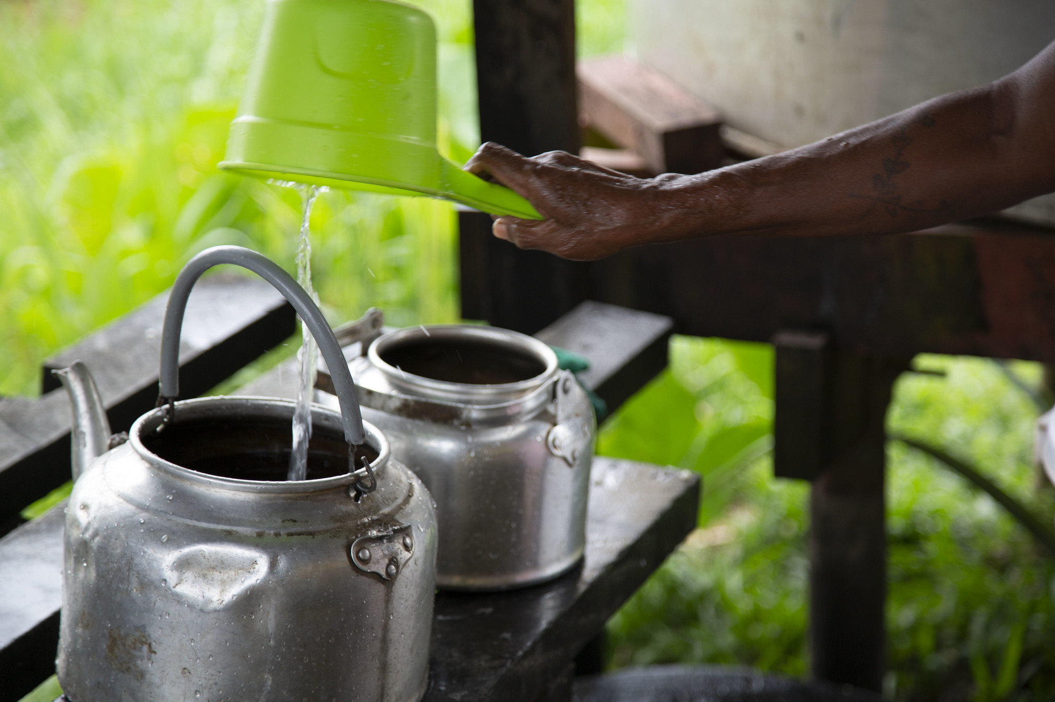
FOOD QUIZ
QUESTION 6
Which food listed below requires the most water to produce?
A. 1kg of beef
B. 1kg of rice
C. 1kg of wheat
Kitchen at school in Malaita, Solomon Islands. 'Water is life' and used in many facets of daily life. Photo credit: Cassandra Hill

Slide 19
FOOD QUIZ
FOOD QUIZ
INCORRECT.
TRY AGAIN!

Slide 20
FOOD QUIZ
QUESTION 6
A. 1kg of beef
CORRECT!
It requires approximately 15,415 litres of water to produce 1 kg of beef, compared to:
3,000 – 5,000 litres of water to produce 1 kg of rice.
2,000 litres for 1kg of soya.
900 litres for 1kg of wheat.
500 litres for 1kg of potatoes.
Kitchen at school in Malaita, Solomon Islands. 'Water is life' and used in many facets of daily life. Photo credit: Cassandra Hill
Notes:
Globally, there is sufficient water to produce food for everyone, but food and nutritional insecurity remains widespread.
http://www.unwater.org/water-facts/water-food-and-energy/

Slide 21
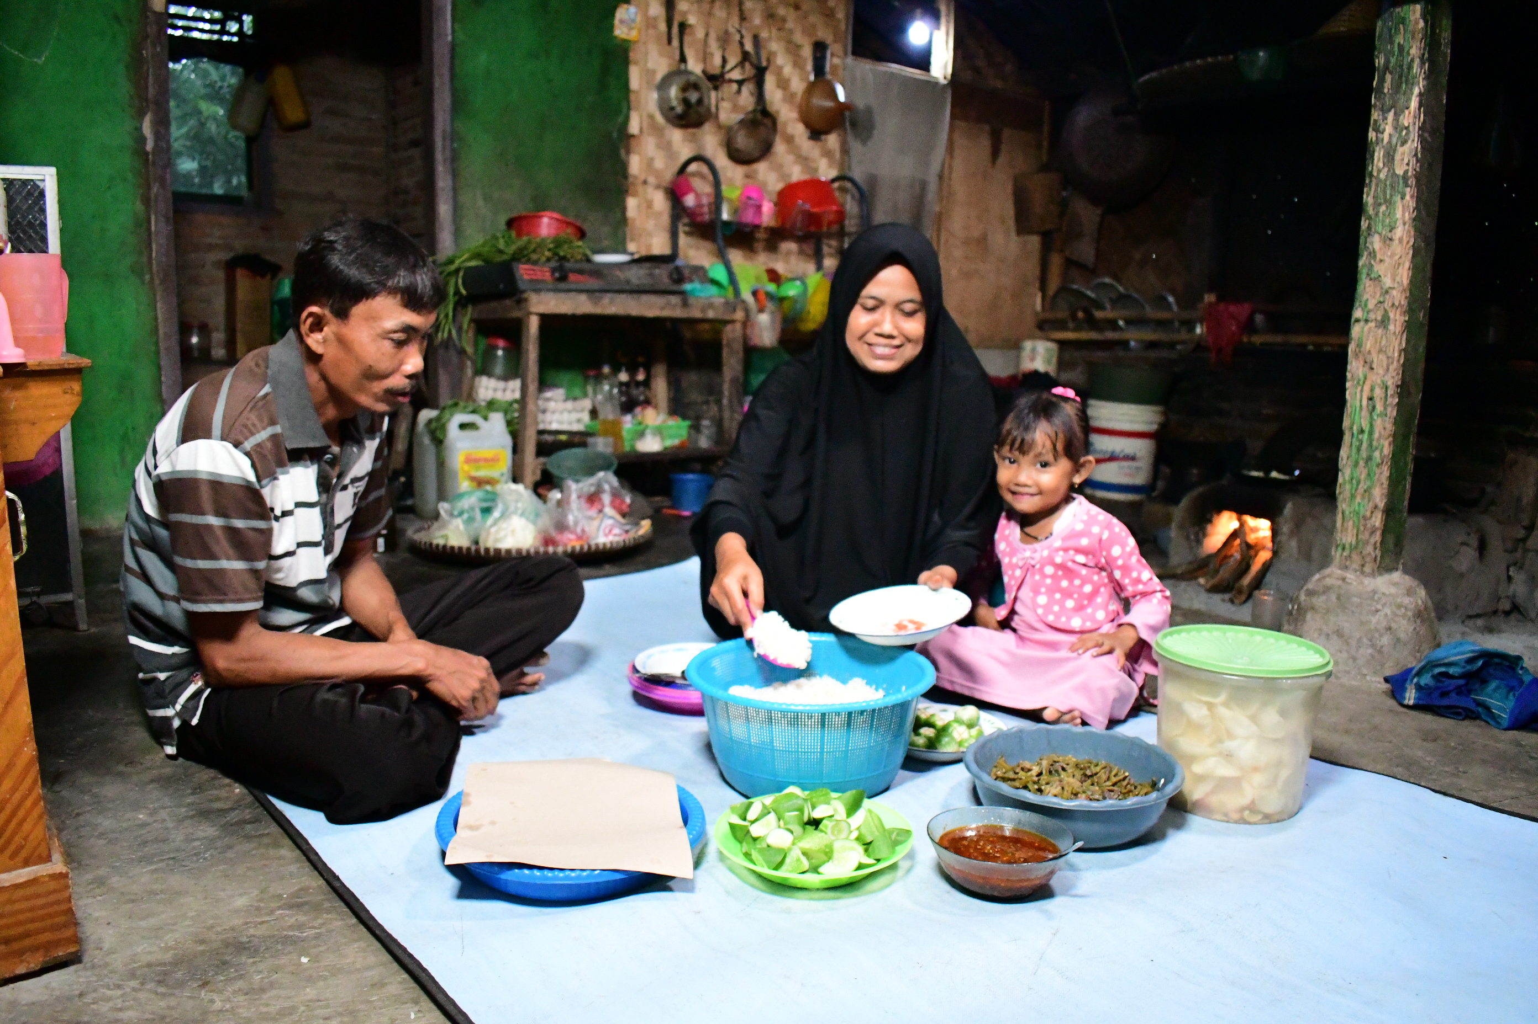
FOOD QUIZ
QUESTION 7
How long can you live without food?
A. 1-2 weeks
B. 4-6 weeks
C. 7-8 weeks
Arsad has a meal with his wife Kasniti and daughter Anita in their home in Pandeglang District, Indonesia.
Photo credit: Laz Harfa

Slide 22
FOOD QUIZ
FOOD QUIZ
INCORRECT.
TRY AGAIN!

Slide 23
FOOD QUIZ
QUESTION 7
B. 4-6 weeks
CORRECT!
But a week is a miracle without water!
This will depend on the person’s body, state of mind, willpower, initial body weight, rate of hydration (or dehydration) and climate.
Arsad has a meal with his wife Kasniti and daughter Anita in their home in Pandeglang District, Indonesia.
Photo credit: Laz Harfa
Notes:
https://www.professorshouse.com/how-long-can-a-person-live-without-food/

Slide 24
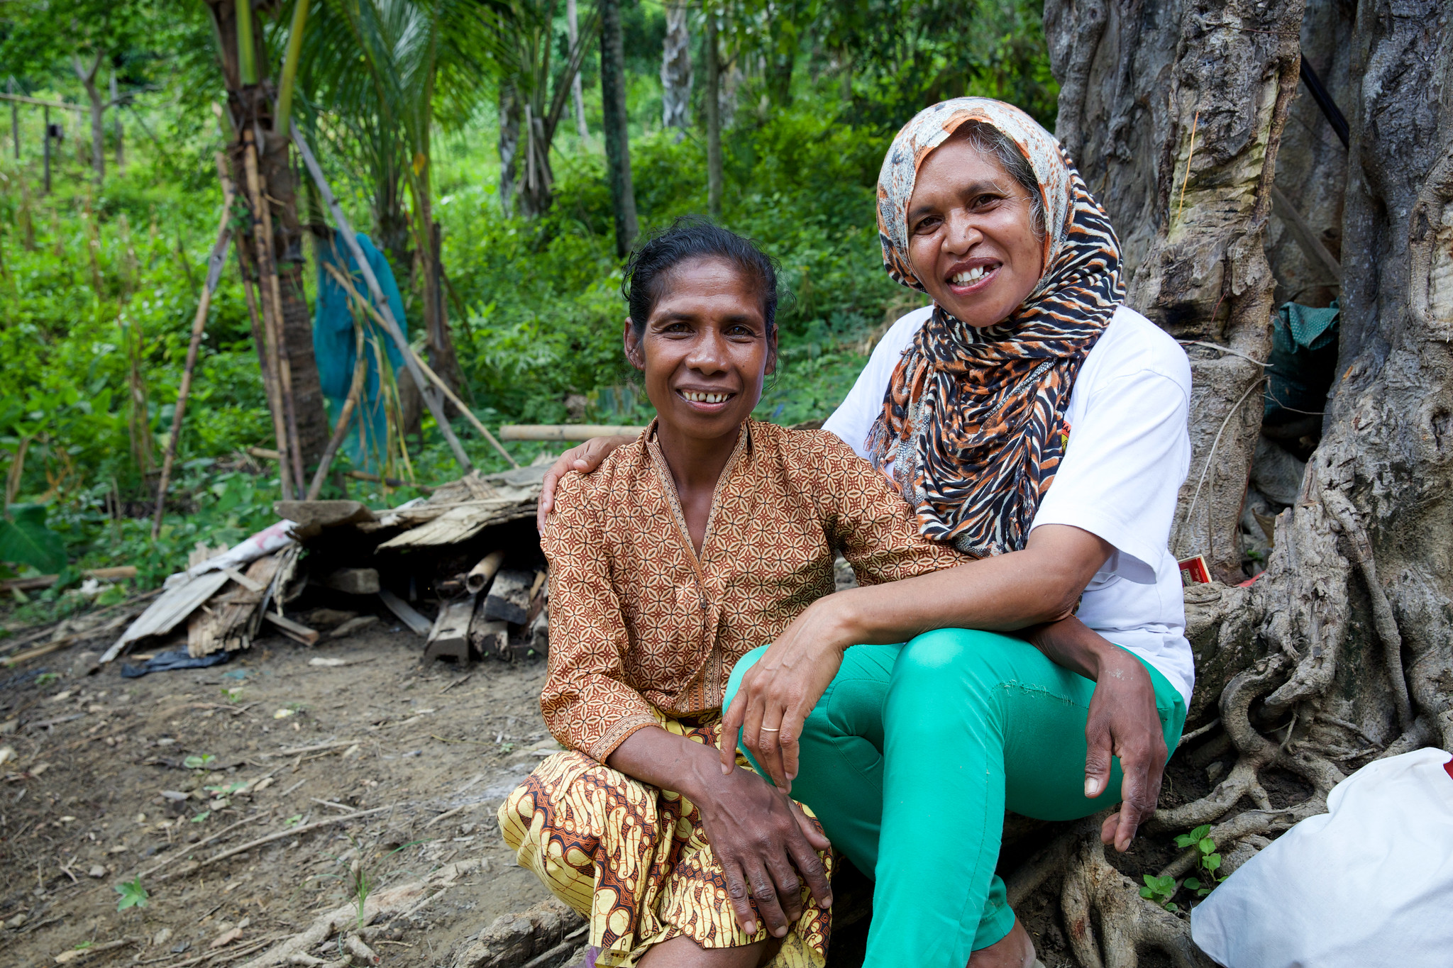
FOOD QUIZ
QUESTION 8
How many kilojoules (KJ) does the average adult need to consume daily?
A. 4700 KJ
B. 6700 KJ
C. 8700 KJ
(Left) Martina outside her home talking with Domingas Tilman, her councillor from Uma Paz women's refuge in Baucau. Photo credit: Richard Wainwright

Slide 25
FOOD QUIZ
FOOD QUIZ
INCORRECT.
TRY AGAIN!

Slide 26
FOOD QUIZ
QUESTION 8
C. 8700 KJ
CORRECT!
An adult needs 8,700 KJ or 2,100 calories per day. These need to be obtained from a variety of sources as part of a diverse diet
(Left) Martina outside her home talking with Domingas Tilman, her councillor from Uma Paz women's refuge in Baucau. Photo credit: Richard Wainwright
Notes:
Nearly everything we eat and drink provides our bodies with energy to fuel our basic body functions and physical activity.
This energy is measured in kilojoules (kJ). When we are active, our bodies burn up more kJ energy.
https://www.8700.com.au/

Slide 27
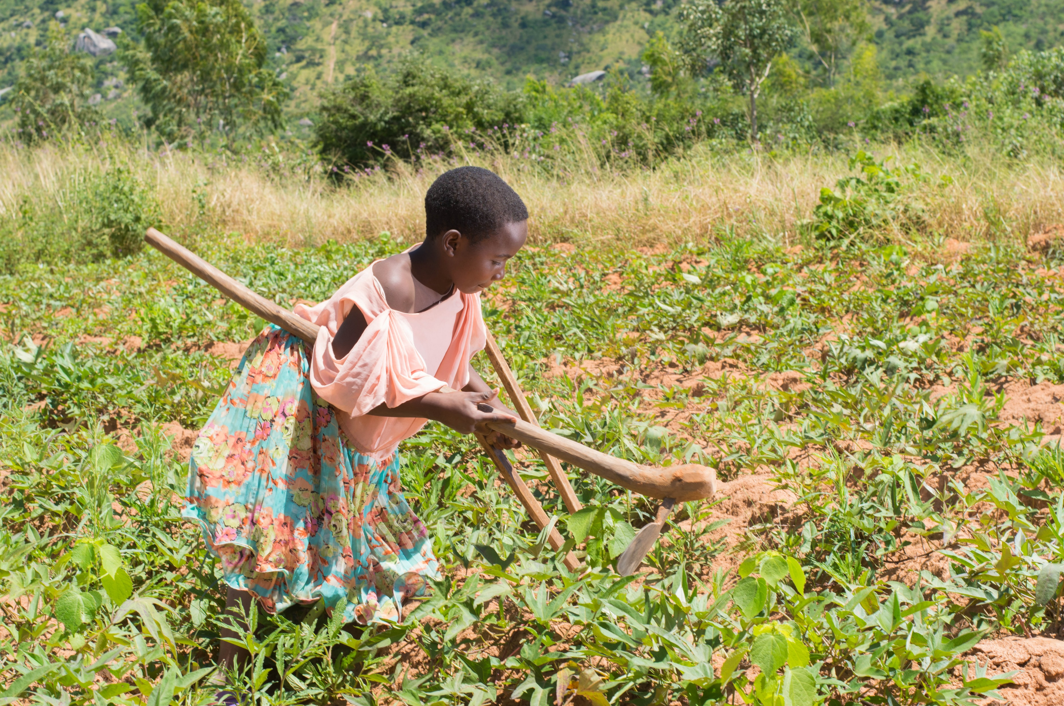
FOOD QUIZ
QUESTION 9
1 in 10 people fall ill every year from eating contaminated food. How many people die each year as a result?
A. 300,000
B. 420,000
C. 700,000
Tawonga her community is blessed with many resources, like rivers, fertile soil and hills. However, with dry spells followed by floods, armyworm infestations and crop failures, her parents struggled to make a living. Although Malawi’s food security has improved, in a country of 19 million people, 6 million still need food aid. Credit: Pilirani Chimombo

Slide 28
FOOD QUIZ
FOOD QUIZ
INCORRECT.
TRY AGAIN!

Slide 29
FOOD QUIZ
QUESTION 9
B. 420,000
CORRECT!
Children under 5 years of age are at particularly high risk, with some 125 000 young children dying from foodborne diseases every year. Proper food preparation can prevent most foodborne diseases.
Tawonga her community is blessed with many resources, like rivers, fertile soil and hills. However, with dry spells followed by floods, armyworm infestations and crop failures, her parents struggled to make a living. Although Malawi’s food security has improved, in a country of 19 million people, 6 million still need food aid. Credit: Pilirani Chimombo
Notes:
Contaminated food can cause long-term health problems
The most common symptoms of foodborne disease are stomach pains, vomiting and diarrhoea. Food contaminated with heavy metals or with naturally occurring toxins can also cause long-term health problems including cancer and neurological disorders.
WHO/P Virot
Foodborne diseases affect vulnerable people harder than other groups
Infections caused by contaminated food have a much higher impact on populations with poor or fragile health status and can easily lead to serious illness and death. For infants, pregnant women, the sick and the elderly, the consequences of foodborne disease are usually more severe and may be fatal.
WHO/V Ariscain
https://www.who.int/news-room/facts-in-pictures/detail/food-safety

Slide 30
FOOD QUIZ
QUESTION 10
Buying local, organic and seasonal food makes a difference to vulnerable communities around the world.
A. True
B. False
Nguyet helping her mother with cooking. Photo credit: Nguyen Minh Duc/Caritas Australia

Slide 31
FOOD QUIZ
FOOD QUIZ
INCORRECT.
TRY AGAIN!

Slide 32
FOOD QUIZ
QUESTION 10
A. True
CORRECT!
By ‘buying local’ you are helping to boost the shift from industrial agriculture towards more sustainable food production systems, favouring small scale food producers.
Nguyet helping her mother with cooking. Photo credit: Nguyen Minh Duc/Caritas Australia

Slide 33
FOOD QUIZ
QUESTION 11
How does Caritas Australia work to improve access to food?
A. Food Aid
B. Training and Programs
C. Both
Ngyuet’s mother working in a rice field. Nguyet appeared in Project Compassion 2019.
Photo credit: Nguyen Minh Duc/Caritas Australia

Slide 34
FOOD QUIZ
FOOD QUIZ
INCORRECT.
TRY AGAIN!

Slide 35
FOOD QUIZ
QUESTION 11
C. Both
CORRECT!
Caritas Australia provides training and tools throughout integrated community development programs while also providing food in emergency situations.
Ngyuet’s mother working in a rice field. Nguyet appeared in Project Compassion 2019.
Photo credit: Nguyen Minh Duc/Caritas Australia
Notes:
https://www.caritas.org.au/about/who-we-are

Slide 36
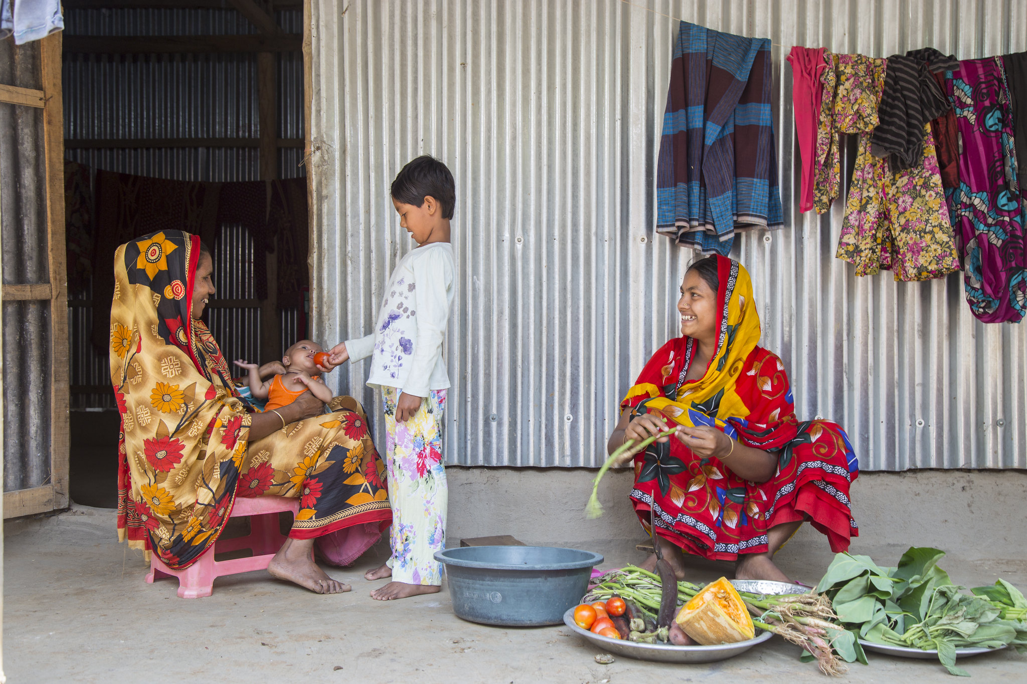
FOOD QUIZ
QUESTION 12
How many people are expected to be undernourished by 2050?
A. 1 billion
B. 1.5 billion
C. 2 billion
Salma lives with her husband Masud and 2 Kids Maya (6) and Samiul (2 months). Her parent in laws are also staying with them. Salma is a home staying mother. She works in house, takes care of her kids and parent in laws. Salma is very much aware about food and nutrition and she cooks different vegetables to get vitamins and minerals. Photo credit: Ashish Peter Gomes/Caritas Australia

Slide 37
FOOD QUIZ
FOOD QUIZ
INCORRECT.
TRY AGAIN!

Slide 38
FOOD QUIZ
QUESTION 12
C. 2 billion
CORRECT!
A profound change of the global food and agriculture system is needed if we are to nourish the 640 million people who are hungry today and the 2 billion people expected to be undernourished by 2050.
These estimates do not take into account the 2020 COVID-19 pandemic which will see this figure increase, particularly in developing nations.
Salma lives with her husband Masud and 2 Kids Maya (6) and Samiul (2 months). Her parent in laws are also staying with them. Salma is a home staying mother. She works in house, takes care of her kids and parent in laws. Salma is very much aware about food and nutrition and she cooks different vegetables to get vitamins and minerals. Photo credit: Ashish Peter Gomes/Caritas Australia

Slide 39
CARITAS AUSTRALIA EDUCATION RESOURCES
For more resources please visit www.caritas.org.au/schools
We would love to hear from you! To send feedback, enquiries or comments, please email us as education@caritas.org.au
Stay up to date with events and resources!
Teachers - Subscribe to Caritas Australia’s Education e-newsletter by emailing your request to education@caritas.org.au
Thank you
CaritasAU @caritasaust @caritasaust caritasaustralia
www.caritas.org.au

