Slide 1
Teacher Information
This resource is intended as a source of information and case studies for teaching and learning about the work of Caritas Australia.
Please refer to the ‘Notes’ section of this presentation for additional information and source references.
It is our hope that you will take part/all of these slides and use them in a way that best suits your purposes. As such, the slides are editable so that the content, case studies and tools included in this resource are flexible for teachers and students to use in classroom instruction, independent student research or presentations.
If you do edit this resource, please ensure content and photos from this resources remain with the appropriate credit to Caritas Australia and the photographers.
For more school resources, please visit: caritas.org.au/resources/school-resources/
Stay up to date with events and resources! Subscribe to Caritas Australia’s Education e-newsletter
Copyright Policy:
Material within our resources come from a variety of sources and authors, including Caritas Australia staff, volunteers, overseas partners and news organisations. These resources and the information, names, images, pictures, logos are provided “as is”, without warranty. Any mistakes brought to the attention of Caritas Australia will be corrected as soon as possible. To review the full Caritas Australia Copyright Policy, please visit: Caritas Australia​​
Links to external sites:
This site contains links to external web sites. Caritas Australia takes no responsibility for the content of such sites, nor do links to such sites imply endorsement of the views expressed therein. External links are provided for informational purposes only.
Updated May 2024

Slide 2
STUDENTS
Learning about challenges to the health, wellbeing and safety of others and our Earth can be hard. If you feel worried or upset about anything you learn about through this resource, make sure you talk to your teacher or trusted adult. They can share your concerns via our website.
Do you have an idea for how Caritas Australia can improve our school resources? We would love to hear it! Please email education@caritas.org.au

Slide 3
First Nations people are advised that this resource and external links may contain images, voices and names of people who have died.

Slide 4
An introduction to Caritas Australia
Primary School Resource
Notes:
Teacher notes:
Begin by asking students what they might already know about Caritas Australia.
Photo: Laxmi (16) facilitating a wall magazine poster making session with Child Club members at her old school in Jajarkot district, western Nepal. Wall magazines are used to highlight issues such as child rights. Photo: Richard Wainwright/Caritas Australia

Slide 5
Our history
Lorenz Worthmann began Caritas in 1897, in Germany.
Caritas Australia was founded in Australia in 1964
For 60 years, Caritas Australia has worked hand-in-hand with the most marginalised and remote communities in Australia and overseas, to confront the challenges of poverty.​
Learn more
A family places coins in a Project Compassion box. Photo credit: The Catholic Weekly 1968

Slide 6
About us
Caritas Australia is the international aid and development agency of the Catholic Church in Australia.
We believe God wants a world where everyone is looked after and treated fairly.
Caritas Australia is all about hope, justice and dignity for all of God’s creation.
We are compassion in action!
Thu fixes a bicycle at his home in Quang Tri province, Vietnam. Photo: Phan Tan Lam/Caritas Australia
Notes:
Teacher notes:
For over 55 years we have been walking alongside the world’s most vulnerable. We work with communities to help them achieve their development goals and build a better future for all. By listening to locals and working together, we create lasting change.
The world ‘Caritas’ is Latin for Love and Compassion.
Our Vision
Justice, dignity and hope for humanity and all of God’s creation.
Our Mission
In the spirit of the Gospel, we work in partnership with communities in Australia and overseas to achieve their development goals and to thrive.

Slide 7
Where we work
Caritas Australia is a member of Caritas Internationalis - the second-largest humanitarian network in the world.

Slide 8
What do we do?
We help people in an emergency. This is called aid.
We help people help themselves by working with communities on things like access to food, water, and healthcare for a better future. This is called community development.
Notes:
Photos
Top: Caritas partners respond to the communities affected by the earthquake in Syria in 2023. Photo: Caritas Network
Bottom: Priscilla holds millet from this year’s harvest in her storeroom at her home in north-western Zimbabwe. Photo: Richard Wainwright/Caritas Australia

Slide 9
What do we do?
We speak up when something is not right. This is called advocacy.
We teach people about how to be good global neighbours. This is called raising awareness.
We raise money to do this work. This is called fundraising.
Let’s learn more about each of these activities…
Notes:
Photo credits: Top to Bottom
L to R Damian Spruce Director of Advocacy at Caritas Australia with Rod Goodbun and Josie Lee from Oxfam Australia and Matt Darvas from Micah at the Global Citizen
Students participate in the Project Compassion launch for Parramatta Diocese.
Students raise money for Project Compassion by selling jelly and other treats at their school.

Slide 10
Aid
We help people in an emergency.
Whenever or wherever a disaster occurs, like an earthquake, flood or war, Caritas Australia can help almost immediately because we are part of a global network.
We deliver food, water, medicine and shelter to people who need it.
Caritas Australia staff speak with local partner at a food distribution point in Ethiopia during the East Africa food crisis in 2023. Photo: Caritas Australia

Slide 11
Aid – An example: Ukraine War
With your help, our partners have been able to assist 4.2 million people affected by the war in Ukraine through a joint emergency response.
For example:
Food - 2 million people
Clean water - 380,000 people
Shelter - 500,000 people
Hygiene supplies - 800,000 people
Medicine – 100,000 people
Caritas agencies deliver food in Ukraine. Photo credit: Caritas Germany.

Slide 12
Community development
Helping people help themselves.
Caritas Australia supports communities to be architects of their own development.
Activities include improving access to:
clean and safe water
healthcare
education
food
income
Janice (right) shows her daughter Tiffany how to prepare pandanus leaves to make fibre artworks to sell at Djilpin Arts, Northern Territory, Australia. Photo: Richard Wainwright

Slide 13
Community Development – An example
In Timor-Leste, unpredictable rainfall, drought and high temperatures have made it hard for Chiquito to grow enough food to feed his family.
Through a Caritas Australia –supported program, Chiquito has learnt new farming techniques to help increase the amount of food he can grow.
Chiquito has also learnt business skills to sell his produce at the markets to increase his income.
Farmers have learnt new farming techniques to combat the effects of climate change in Timor-Leste. Photo: Tim Lam/caritas Australia

Slide 14
Advocacy
Advocacy requires listening to the needs of others and helping other people listen too.
We speak up when something is not right.
Laxmi (16) leading a rally with Child Club members calling for the protection of child rights. Photo: Richard Wainwright/Caritas Australia

Slide 15
Advocacy – An example
Caritas Australia is participating in the Safer World For All campaign along with other individuals and community groups.
This campaign calls on our leaders to act now to build a safer world for all by:
Increasing the amount of money we spend on aid
Making things fair around the world
Helping to address climate change.
Damian Spruce Director of Advocacy at Caritas Australia with Rod Goodbun and Josie Lee from Oxfam Australia and Matt Darvas from Micah at the Global Citizen

Slide 16
Raising awareness
Teaching others about the issues in our world.
This helps us be more compassionate and work towards a more just and fair world.
You might learn about how to be a good global neighbour or how to care for the Earth.
Students learn about the work of Caritas Australia at the launch of Project Compassion in the Diocese of Parramatta. Photo: Diocese of Parramatta.

Slide 17
Raising Awareness – An example
Catholic Earthcare is part of Caritas Australia and can help your school or parish love and look after the Earth better.
We help children and adults understand why it is important to care for each other and all of creation.
Learn about Global Issues
Students care for creation to prevent coastal erosion.
Become an Earthcare School

Slide 18
Fundraising
We raise money so we can continue our great work.
When you raise money at your school, or make a donation, the money is used to help us continue to support communities in Australia and around the world have a brighter future.
Year 5 Social Justice leaders from St Columba's Elwood promote Caritas Australia during Lent. Photo credit: Studio Lemon /Saskia Koffijberg

Slide 19
Fundraising– An example
Students at St Joseph’s primary school participated in a Walk for Water challenge during Project Compassion.
They filled their buckets with water and completed a challenging course, trying not to spill any water.
The school community raised over $12,000 with their Walk for Water Challenge.
Students participate in a Walk for Water Challenge. Photo: St Joseph’s primary School, Schofields.

Slide 20
Why do we do this work?
God teaches us to love everyone.
We are inspired by:
Jesus
The Bible
Encyclicals (letters) by Popes:
Laudato Si teaches us to care for the earth and each other.
Fratelli Tutti teaches us about friendship and love.
Five-year-old Clark (right) kisses his younger brother Egzy Grey (3) on the cheek in their small home in Quezon City, Philippines. Photo: Richard Wainwright/Caritas Australia
Notes:
Teacher’s Notes:
We are inspired by the Gospel which finds its expression in Catholic Social Traditions.
Jesus returned as a young adult to his home town of Nazareth (Luke 4: 16-30). He had just returned from forty days in the desert, a time of encounter with both darkness and light. He chose light. Coming home, he knew this meant a fresh way of understanding himself and the world. He was to be an agent for change, for loving relationships. He had a vision of freedom. It is a vision we share, one of justice, dignity and hope, and is deeply rooted in everything we do, including the Caritas Australia mission.
Resources for further learning
Fratelli Tutti Primary Resource: https://www.caritas.org.au/resources/school-resources/fratelli-tutti-primary
Laudato Si’ Primary Resource: https://www.caritas.org.au/resources/school-resources/the-laudato-si-goals-primary
Oscar Romero Biography: https://www.caritas.org.au/resources/school-resources/oscar-romero-biography

Slide 21
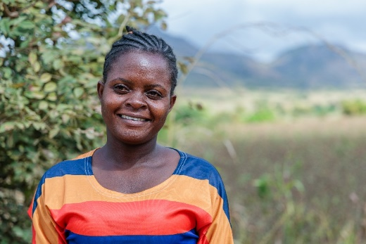
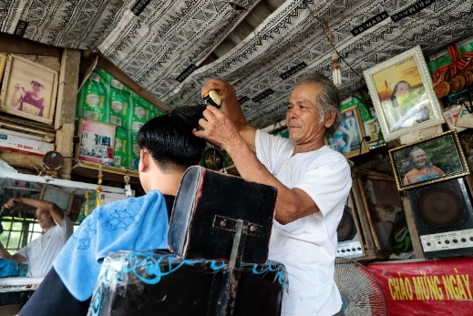
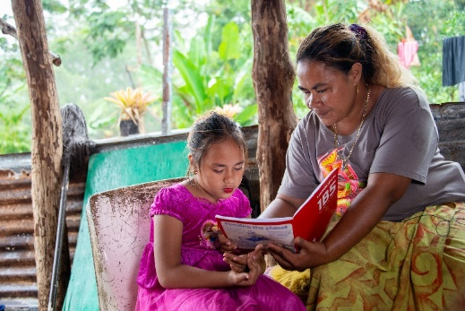
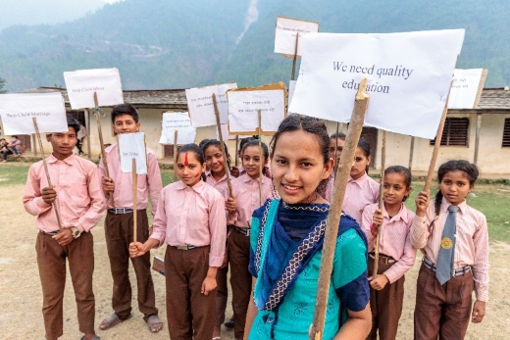
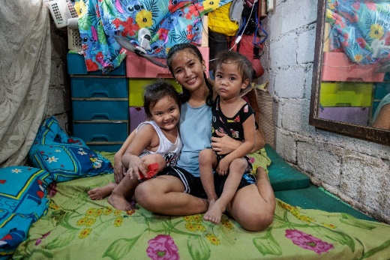
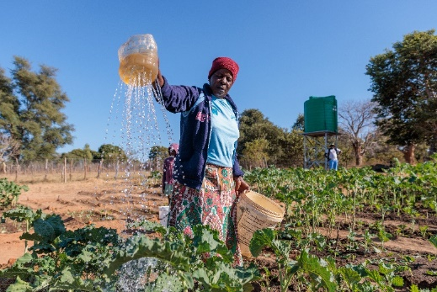
We are guided by the principles of Catholic Social Teaching
Everyone is special.
Human Dignity
What is best for everyone?
The Common Good
Solidarity
We are one big family.
All people should have a say!
Subsidiarity
Participation
We all want to work
and contribute to our communities.
We are part of
and need to care for creation.
Care for Our Common Home
Preferential Option for the Poor
Some people need extra help.
Notes:
Left (top to bottom)
- Memory participated in a Caritas Australia supported program in Malawi, becoming the first female carpenter from her village. Photo: Tim Lam / Caritas Australia
-A mother reads to her daughter in Samoa. Photo: Laura Womersley /Caritas Australia
- Ronita (22) smiles as she holds her sons, Egzy Grey (3) and Clark (5), in their small home in Quezon City, Philippines. Photo: Richard Wainwright/Caritas Australia
Right (top to bottom)
- Thu working in his barber shop at his home in Quang Tri province, Vietnam. Thu set up the barber shop after receiving a loan when he joined a local VSLA. Photo: Phan Tan Lam/Caritas Australia
- Laxmi (16) leading a rally with Child Club members calling for the protection of child rights. Photo: Richard Wainwright/Caritas Australia
- Priscilla holds millet from this year’s harvest in her storeroom at her home in Hwange district, north western Zimbabwe. Photo: Richard Wainwright/Caritas Australia

Slide 22
How do we work with others?
Working together is really important and effective. We have partner organisations who work with communities all around the world.
We start a project by listening to communities share their vision and goals. We are there for them and to help them achieve their goals.
Leaia’s family received a water tank through a Caritas Australia-supported program with Caritas Samoa.
Notes:
Teacher notes:
Accompaniment means walking side-by-side with our program partners. It means supporting them and following their lead.
We accompany our program partners by providing:
Training and mentoring
Technical support
Risk management
Organisational development
Funding
Amplifying their voices
Learn more about our approach to development here: https://www.caritas.org.au/about/what-is-caritas/our-approach/

Slide 23
How do we work with others?
Nobody has nothing and everyone is good at something! Communities start by looking at their strengths. What are they good at and what do they already have.
Together, we find ways to build on their strengths to improve things for everyone. The communities lead the way to a better future and we are proud to help them along the way. This is called the Strengths-based Approach.
Tarsini (centre) meets with her Village Savings and Loans Group at her home. Photo: Laz Harfa
Notes:
Teacher notes:
Accompaniment means walking side-by-side with our program partners. It means supporting them and following their lead.
We accompany our program partners by providing:
Training and mentoring
Technical support
Risk management
Organisational development
Funding
Amplifying their voices
Learn more about our approach to development here: https://www.caritas.org.au/about/what-is-caritas/our-approach/

Slide 24
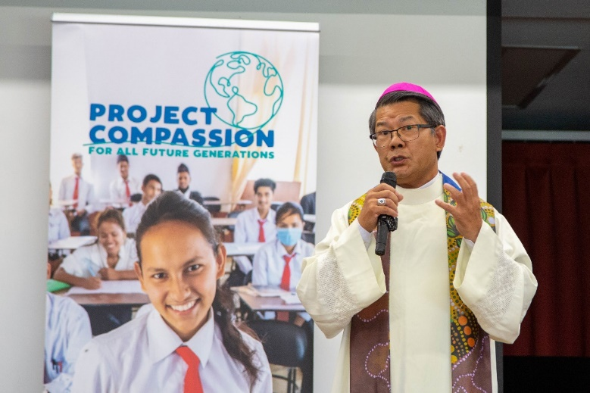
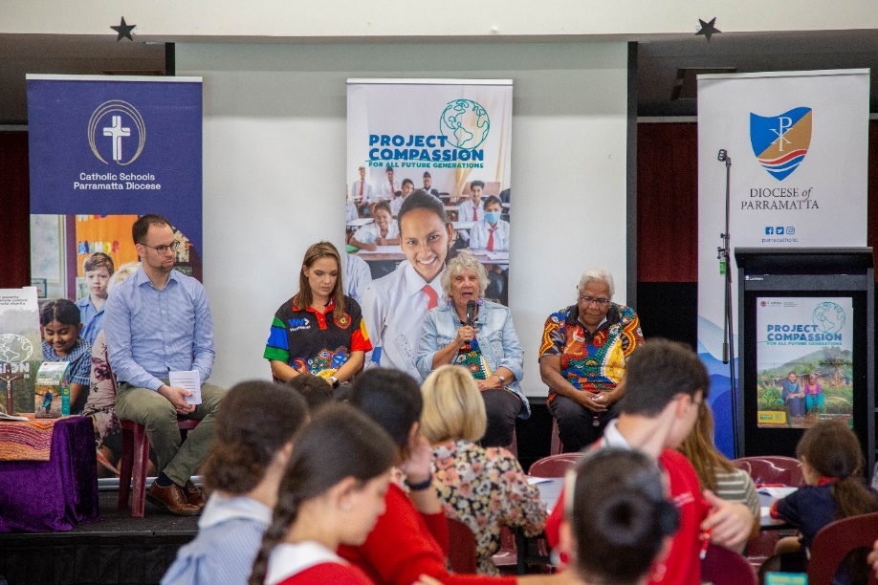
How can you help?
Ways you can take action:
Fundraise
Talking to others about global issues
Caring for creation
Keep learning
Notes:
Top right and off-centred left. Parramatta Schools Project Compassion Launch 2023. Photo: Parramatta Schools, Richard Wainwright/Caritas Australia.
Bottom right. Laxmi (16) and Child Club members calling for child rights, such as access to education and stopping child marriage and child labour, through villages near her home in Jajarkot district, western Nepal. Photo: Richard Wainwright/Caritas Australia.

Slide 25
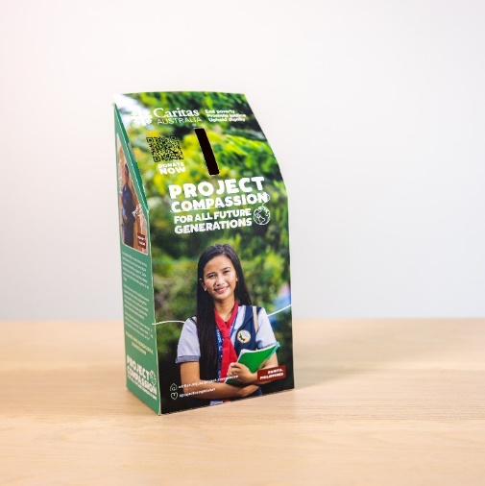
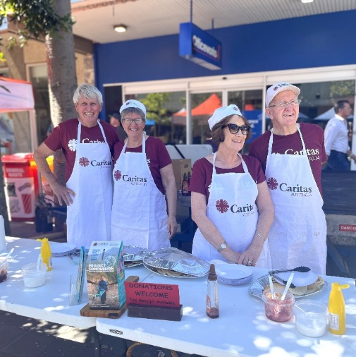
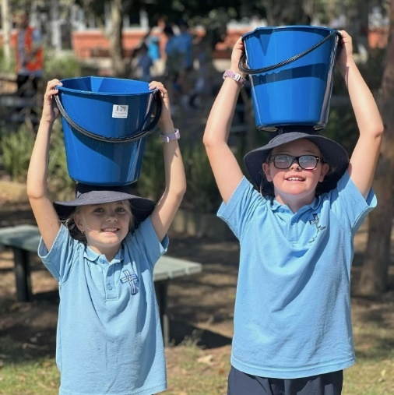
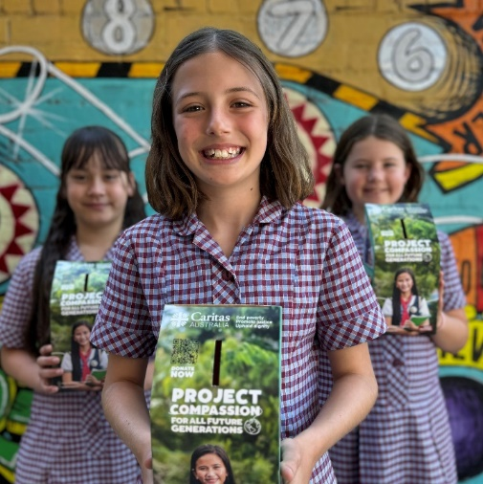
Fundraising ideas
Project Compassion
Pancake Tuesday
Global Gifts
Caritas Challenge
Donation
Notes:
L- R Project Compassion Box. Photo: Caritas Australia; Caritas Cooks from Sandhurst preparing to serve Pancakes Photo: Caritas Australia; Global Gifts Global Gifts (caritas.org.au) Photo: Caritas Australia; Students from St Thomas More Primary School Alfredton caring buckets of water as part of their Water Challenge. Photo: St Thomas More Primary School Alfredton; Year 5 Social Justice leaders from St Columba’s Elwood Primary School promoting Caritas during Lent. Photo: Studio Lemon/Saskia Koffijberg.

Slide 26
END POVERTY
PROMOTE JUSTICE
UPHOLD DIGNITY

