Slide 1
Teachers
This PowerPoint contains information on the strengths-based approach to community development (SBA). It begins with an exploration of student’s own understanding of the Catholic Social Teaching principle of Human Dignity, explores the main principles of the SBA and what it looks like in practice in Caritas Australia’s programs in Malawi and then encourages students to think about their collective strengths.
This approach to development strongly aligns with current research and practice related to the concept of resilience. It is an approach that can provide useful reflections for our lives and that of our school communities.
You will find suggested activities and further information in the ‘Notes’ section of each slide. Please refer to these to get the most out of this presentation.
For more school resources, please visit: caritas.org.au/resources/school-resources/
Stay up to date with events and resources! Subscribe to Caritas Australia’s Education e-newsletter
To review Caritas Australia’s Copyright Policy, please visit: Caritas Australia​​
Updated May 2024

Slide 2
Strengths-based Approach to Community Development
Primary School Resource
Notes:
Photo credit: Laz Harfa

Slide 3
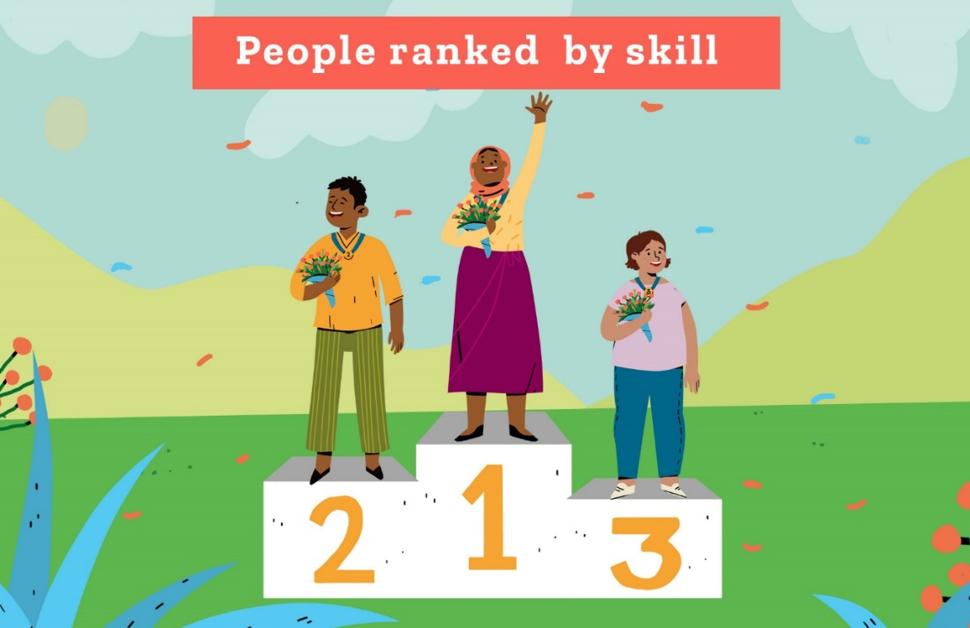
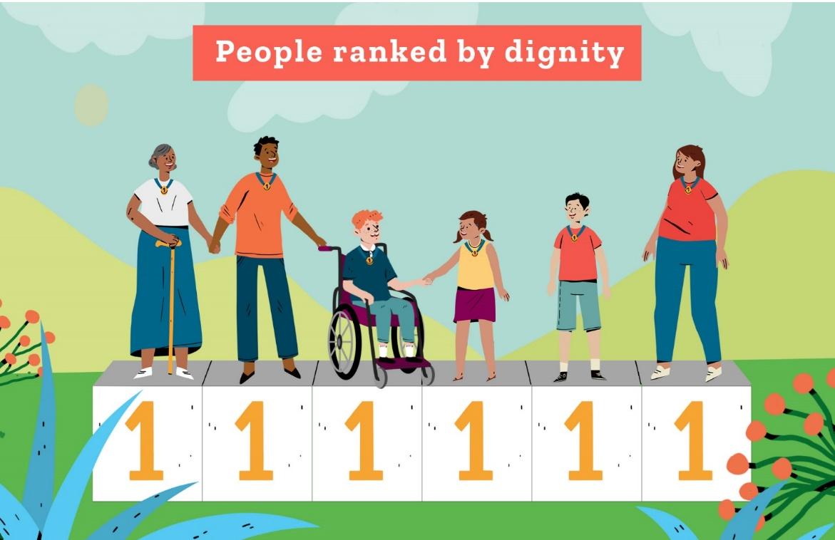
Human Dignity
Every person is made in the image and likeness of God. This means that everyone is special and has God-given dignity.
Notes:
God has gifted each one of us with talents and abilities – some that are similar to the talents and abilities of others - and some that are unique.
For more resources on Dignity and the other Catholic social teaching principles, see our online toolkit: www.caritas.org.au/CST

Slide 4
Human Dignity
We each have talents and abilities that God has blessed us with. When we identify these and combine them with everybody else's gifts and strengths, we realise that together we can achieve far more than when everybody works alone.
We call this a Strengths-based Approach.
This is the same in your classroom as it is in the communities that Caritas Australia works with all around the world!

Slide 5
Nobody has nothing
When we see images of communities who are living in poverty we can focus on what they don’t have.
Caritas Australia believes that each person has God-given gifts and strengths.
Nobody has nothing.
Everyone in the community regardless of who you are or how old you are, everyone has something to contribute.
Leaia and her children walk to collect water in Samoa. Photo: Laura Womersley/Caritas Australia

Slide 6
Nobody has nothing
Development programs are activities that support families and communities to have what they need. They can include increasing food supplies, accessing clean water, education and training, health programs and how to increase income etc.
Traditionally, international development programs have focused on the needs and problems that communities face.
Ronita (22), in her school uniform, walks down a local street in Quezon City, Philippines, on her way to school. Photo: Richard Wainwright/ Caritas Australia
Notes:
Working towards the Common Good means thinking about what is good for everyone, not just ourselves.

Slide 7
Nobody has nothing
But with the Strengths-based Approach, community members recognise their collective strengths and assets and work together towards the Common Good*.
This leads to stronger, more resilient communities and successful programs.
Chiquito (left) and his family members work together on their farm in Timor-Leste. Photo: Tim Lam/ Caritas Australia
* Thinking about what is good for everyone, not just ourselves.
Notes:
Working towards the Common Good means thinking about what is good for everyone, not just ourselves.

Slide 8
Needs vs Strengths
What do you see?
A glass half-empty…
or half-full?
Photo: Tropical Cyclone Pam has caused widespread destruction in Vanuatu. Credit: Adventist Development and Relief Agency.

Slide 9
Needs vs Strengths
All too often, development programs have only paid attention to the half-empty part: people’s needs and problems.
The Strengths-based Approach focuses on the glass being half-full: this is where the strengths, gifts and talents of a community lies.
Photo: Tropical Cyclone Pam has caused widespread destruction in Vanuatu. Credit: Adventist Development and Relief Agency.

Slide 10
Strengths can be:
Human |  | Natural |  | Social
 | skills knowledge labour compassion helping |  | land water fertile soil animals |  | social networks groups/clubs associations organisations
Physical |  | Financial
 | roads and bridges schools clinics transport water supply |  | cash livestock grain stores savings
Notes:
Think about the different communities you are a part of. What strengths and assets do you have collectively, that you could use to work for social justice?

Slide 11
Strengths-based approach
Through our partners, Caritas Australia supports communities to:
outline their strengths
dream for the future
set realistic goals
Caritas Australia assists communities by providing physical resources and technical knowledge so they can work towards breaking the cycle of poverty.
Tarsini (centre) meets with her Village Savings and Loans Group at her home. Photo: Laz Harfa
Notes:
Source: https://databankfiles.worldbank.org/public/ddpext_download/poverty/987B9C90-CB9F-4D93-AE8C-750588BF00QA/current/Global_POVEQ_MWI.pdf https://hdr.undp.org/sites/default/files/Country-Profiles/MPI/TZA.pdf

Slide 12
SEE – THINK – WONDER
These photos are from Malawi. When you look at the images what do you see? What do you think about the community and the place? What do you wonder?
Notes:
Photo captions (L-R):
Memory sweeping leaves from the ground outside her family home in Mwanza district, southern Malawi. Photo: Tim Lam/Caritas Australia
Memory (centre) with her parents, Lector and Lute, and siblings in their village in Mwanza district, southern Malawi. Photo: Tim Lam/Caritas Australia
Memory’s former teacher Billy trains the next generation of carpenters at a technical college near the city of Blantyre. Photo: Tim Lam/Caritas Australia

Slide 13
Case Study - Malawi
Memory and her family live in a remote village in Malawi. Malawi is one of the poorest countries in the world and many families don’t have enough food to eat. But after working with Caritas Australia’s local partner CADECOM, Memory’s family and community are now enjoying the results from their hard work.
Memory on her family farmland near their village in Mwanza district, southern Malawi. Photo: Tim Lam/Caritas Australia

Slide 14
Growing more food
Memory’s family and community have many strengths. They have land, farming tools and time to farm, but they found it hard to grow enough food to eat.
Building on these strengths the community has learnt new irrigation farming techniques with the support of CADECOM.
Now they can grow more food from the land they have.
Memory (left) and her family are seen on their farmland near their village in Mwanza district, southern Malawi. Photo: Tim Lam/Caritas Australia

Slide 15
Raising goats
Community members save money together through a Village Savings and Loans Group.
Members can then borrow some money (loan) for an activity and then pay the group back so another member can borrow money for their activity.
Memory’s parents were very happy to receive a goat as members of their Village Savings and Loans Group.
Memory’s parents, Lector and Lute, carrying a goat that was provided to them by CADECOM. Photo: Tim Lam/Caritas Australia

Slide 16
Selling honey and caring for the environment
Another strength of the community was the land and natural environment. The community have been able to use this beautiful area to start beekeeping.
Now they can collect honey to sell while also caring for their local environment which is good for the community and the bees!
Community members wearing beekeeping suits collect honey from a bee hive. Photo: Caritas Australia

Slide 17
Handwashing
Families have used their skills to build handwashing devices to stay healthy.
Many communities do not have access to clean, running water; which is crucial in reducing the spread of diseases. The simple act of washing hands with soap and water can reduce diarrhoea by over 40 percent.*
*Source: United Nations
Vellina washes her hands outside her home in Malawi. Photo: Tim Lam / Caritas Australia

Slide 18
Income generation
The community grow lots of bananas which they use to make banana wine.
They sell the wine to earn money to buy other things they need.
As part of the Caritas Australia-supported program, community members have learnt to make banana wine as an income generating activity. Photo: Tim Lam / Caritas Australia.

Slide 19
Income generation
Through the Strengths-based Approach, Memory and her community have learned to use their strengths to grow more food, increase their income and stay healthy!
Along with your generous support, this program is also supported by the Australian Government, through Australian NGO Cooperation Program (ANCP).
Memory (centre) with her parents, Lector and Lute, and siblings in their village in Mwanza district, southern Malawi. Photo: Tim Lam/Caritas Australia

Slide 20
What are our strengths?
Think about the different communities you are a part of.
What strengths and assets do you have collectively, that you could use to work for social justice?

Slide 21
Students
Learning about challenges to the health, wellbeing and safety of others and our earth can be hard. If you are feeling worried or upset about anything you have learnt about through this resource, make sure you talk to your teacher or trusted adult. They can share your concerns via our website.
Do you have an idea for how Caritas Australia can improve our school resources? We would love to hear it! Please email education@caritas.org.au

Slide 22
Credits
Content adapted in part and with permission from the Coady International Institute, St Francis Xavier University.

