Slide 1
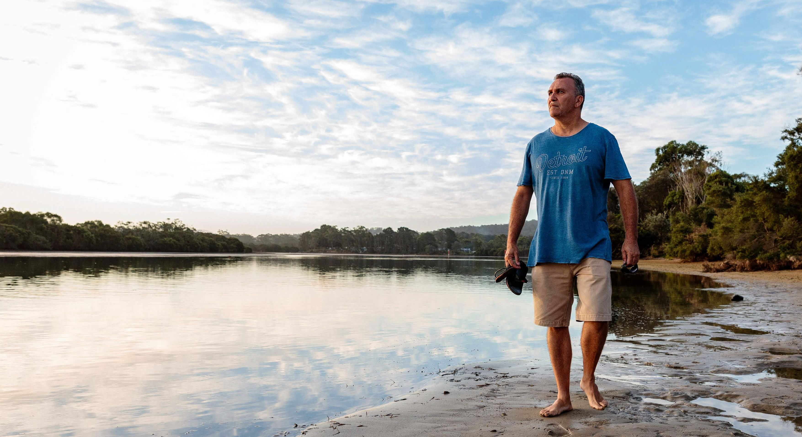
RESPONSE TO THE CRY OF THE EARTH
Creator God,
You fill the earth with life.
Lead us to live in harmony with your creation.
May we respect all life from the smallest of plants to the tallest of trees, the vastness of the oceans to the majesty of mountains and the tiniest insects to the wildest beasts.
Photo credit: Richard Wainwright/Caritas Australia

Slide 2
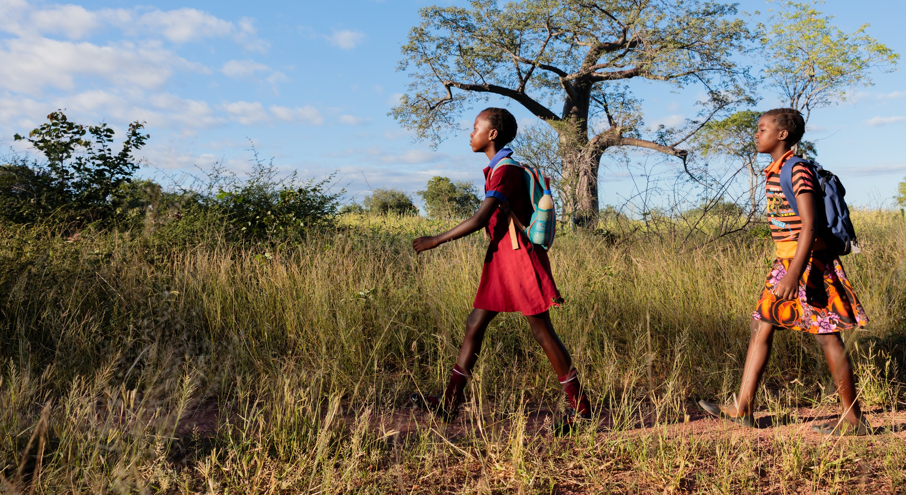
RESPONSE TO THE CRY OF THE POOR
God of Compassion,
You made us in your image and likeness,
Open our eyes to see you in others,
Open our ears to your cry,
And open our hearts to love like you,
So that we may live as one human family.
Photo credit: Richard Wainwright/Caritas Australia

Slide 3
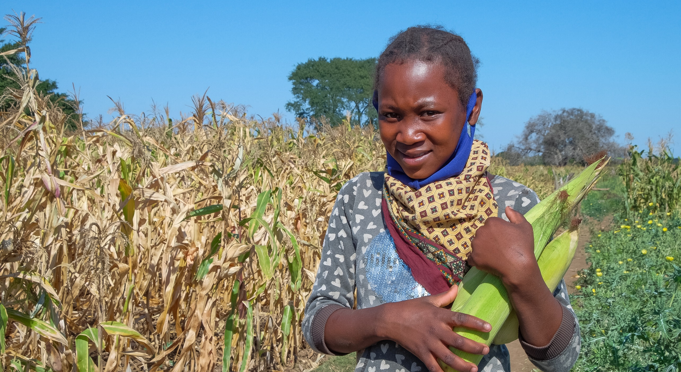
ECOLOGICAL ECONOMICS
God of Wisdom,
You gifted us with right judgement and courage.
Help us to share the earth’s resources fairly and to use them wisely.
Stand with us as we speak out against inequality and injustice. Guide our thoughts and actions as we care for our common home.
Photo credit: Emidio Josine/Caritas Australia

Slide 4
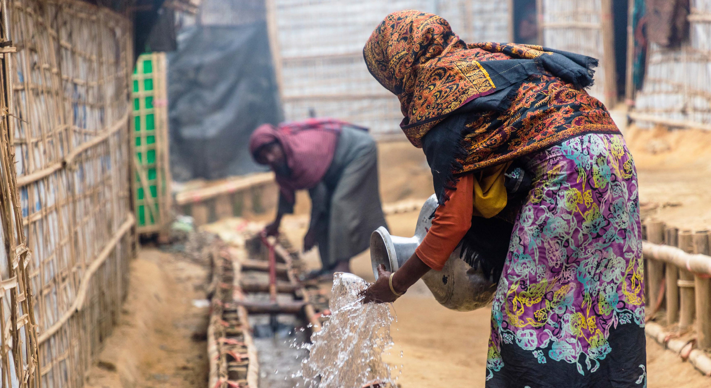
ADOPTION OF SUSTAINABLE LIFESTYLES
God of Love,
You walk beside us, guiding our path,
Teach us to simplify our lives, to pause, to slow our steps and to
be mindful of all of creation, so that we may truly enjoy the richness of your love.
Photo credit: Christopher Riechert/Catholic Relief Services

Slide 5
ECOLOGICAL EDUCATION
God of All,
You teach us how to live so that others may simply live.
Through our words and actions may we inspire others to do the same.
Photo credit: Sascha Costigan/Caritas Australia

Slide 6
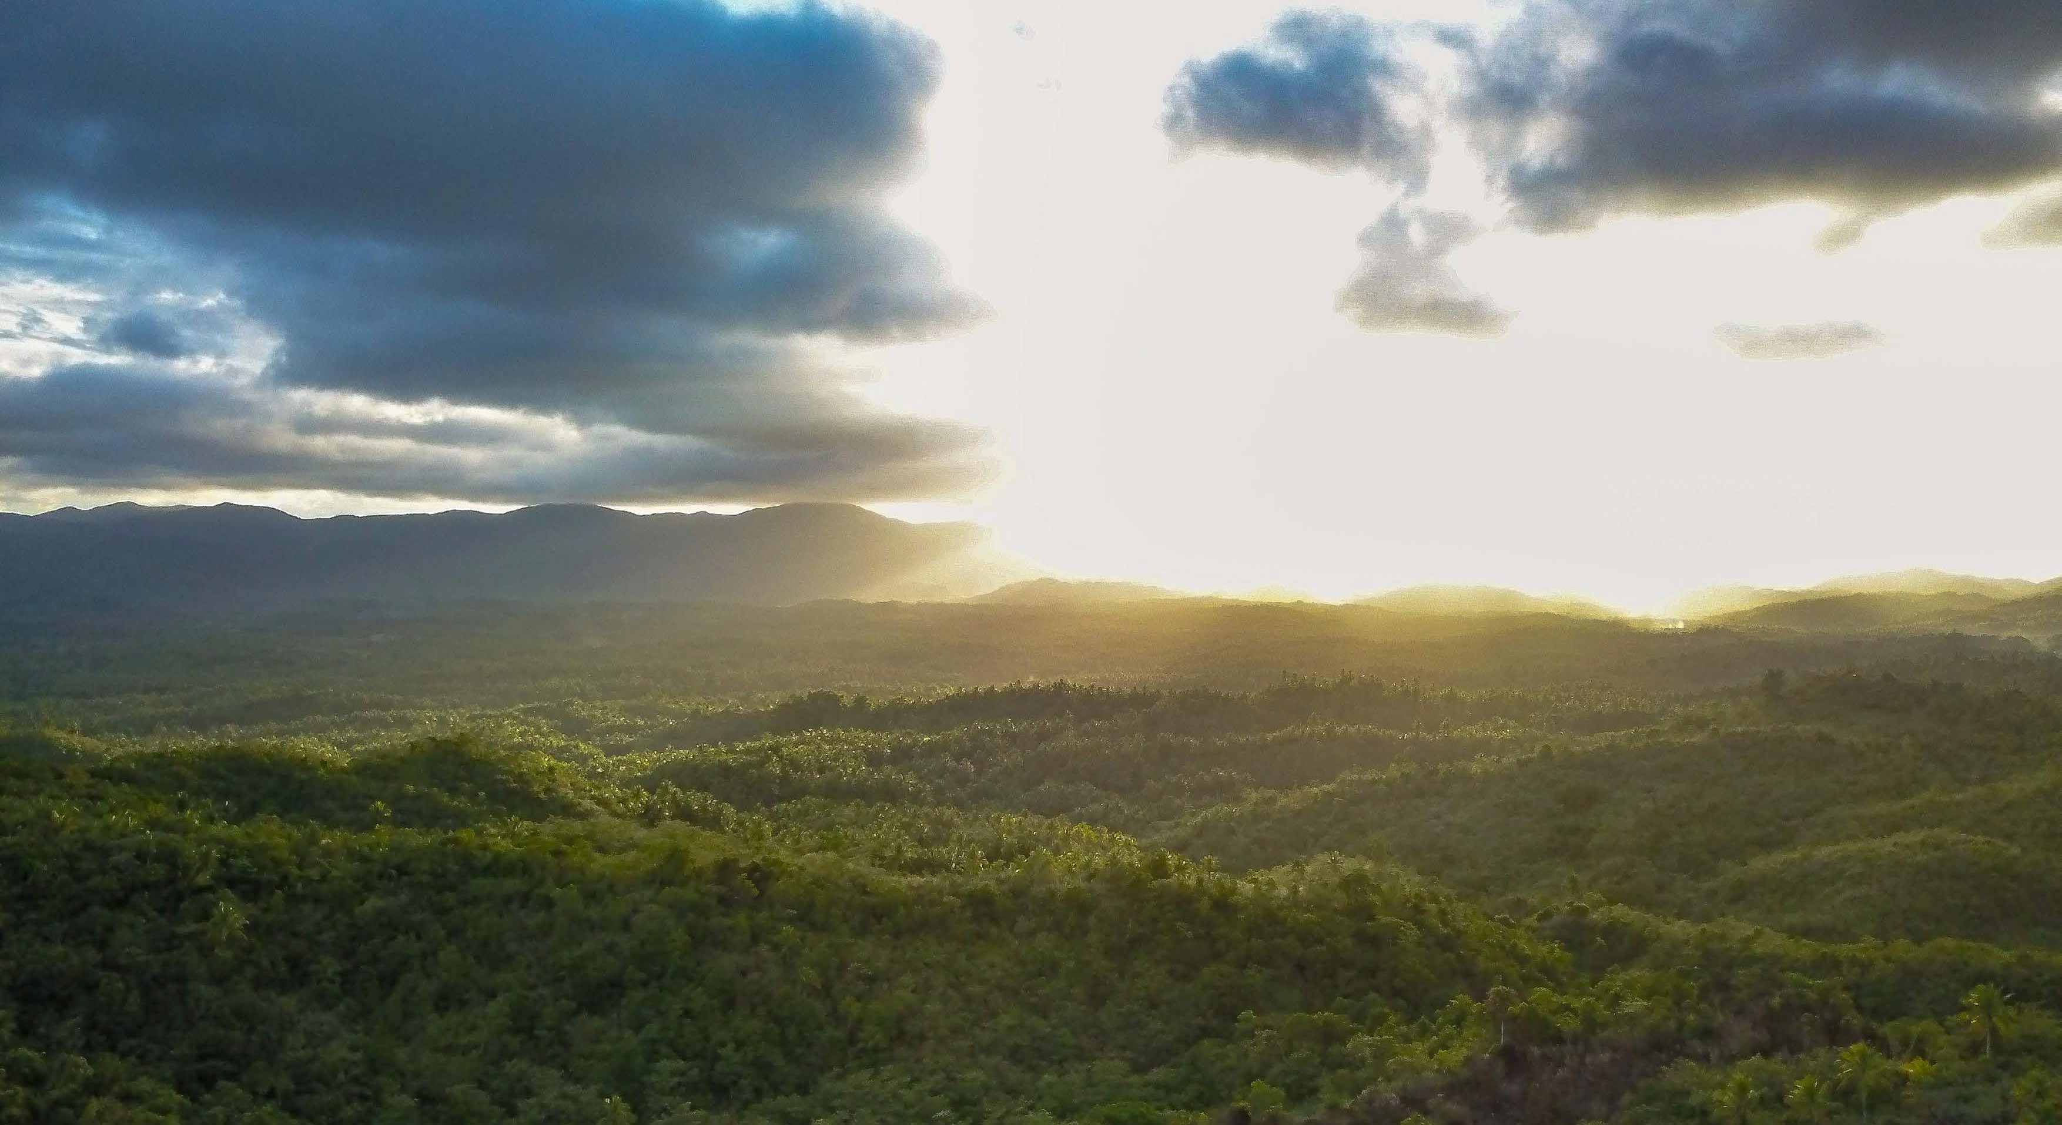
ECOLOGICAL SPIRITUALITY
God, source of all life,
You bless us with the gift of creation.
Inspire us to gaze in wonder and awe at the beauty that surrounds us.
Photo credit: Richard Wainwright/Caritas Australia

Slide 7
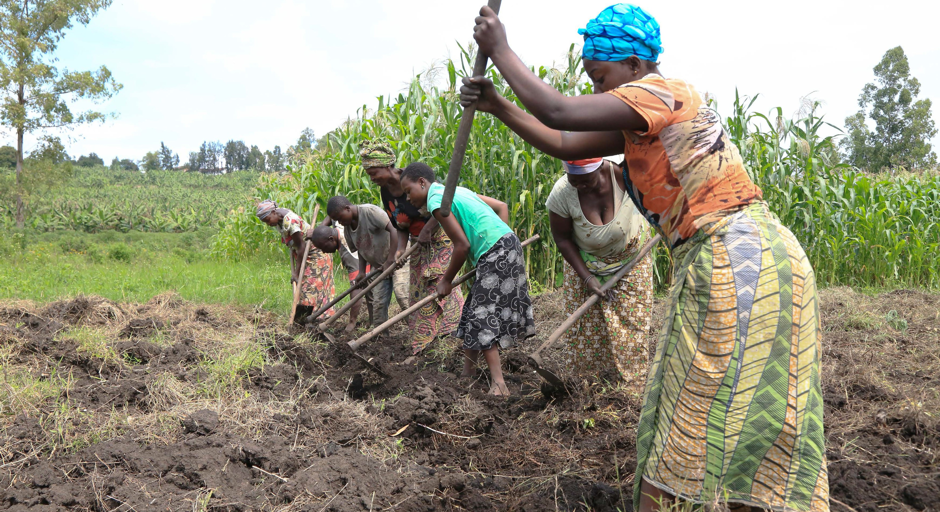
COMMUNITY RESILIENCE AND EMPOWERMENT
God of Justice and Love, You lead us on life’s journey through creation.
Guide us to act justly, love tenderly and walk humbly in your ways.
We ask this in your name.
Amen
Photo credit: Lulu Mitshabu/Caritas Australia & Caritas Goma

