Slide 1
How to use this resource
This resource is intended as a source of information for teaching and learning about issues surrounding poverty across several curriculum areas and units. The points raised will be explored further in the teaching resources found at the end of these slides.
Please refer to the ‘Notes’ section of this presentation for additional information and source references.
It is our hope that you will take part/all of these slides and use them in a way that best suits your purposes. If you do edit this presentation, please ensure content and photos from this resources remain with the appropriate credit to Caritas Australia and the photographers.
Note: This PowerPoint is editable so you can adapt it to your needs. If you do edit this resource, please ensure content and photos remain with the appropriate credit to Caritas Australia and the photographers.
Copyright Policy: Material within our resources come from a variety of sources and authors, including Caritas Australia staff volunteers, overseas partners and news organisations. These resources and the information, names, images, pictures, logos are provided “as is”, without warranty. Any mistakes brought to the attention of Caritas Australia will be corrected as soon as possible. To review the full Caritas Australia Copyright Policy, please visit: Caritas Australia​

Slide 2
Curriculum links
RELIGIOUS EDUCATION
There are many Religious Education Curricula around the country, however it is not surprising that there are many common themes. Here are the common themes in this resource.
Living the mission of Jesus
Loving our neighbours
Catholic Social Teachings: Human Dignity, Preferential Option for the Poor, Solidarity, Subsidiarity and Participation, Care for our Common Home and the Common Good.
GEOGRAPHY
Year 6
Differences in the economic, demographic and social characteristics of countries across the world (ACHASSK139)
Australia’s connections with other countries and how these change people and places (ACHASSK141)
CIVICS AND CITIZENSHIP
Year 6
The obligations citizens may consider they have beyond their own national borders as active and informed global citizens (ACHASSK148)
ECONOMICS AND BUSINESS
Year 5
The difference between needs and wants and why choices need to be made about how limited resources are used (ACHASSK119)
Types of resources (natural, human, capital) and the ways societies use them to satisfy the needs and wants of present and future generations (ACHASSK120)
Year 6
How the concept of opportunity cost involves choices about the alternative use of resources and the need to consider trade-offs (ACHASSK149)

Slide 3
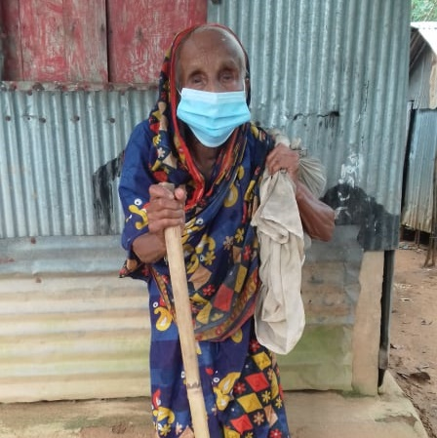
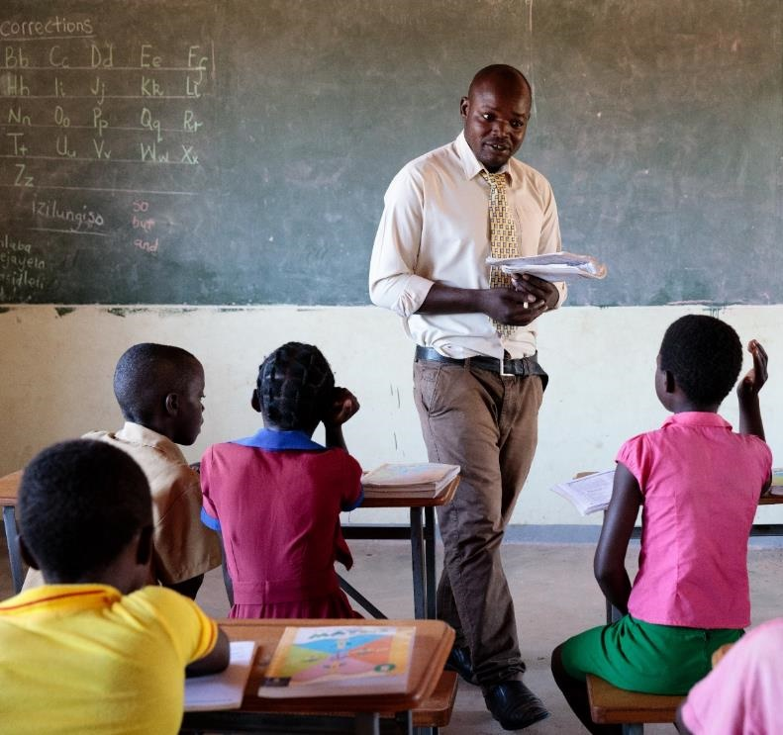
Root Causes of Poverty
Notes:
Photo credits (left to right)
Salma spends quality time with her newborn baby boy and her daughter in Bangladesh. They tell stories and play games. Photo credit: Ashish Peter Gomes
Afiron is 100 years old and live near Bangladesh’s border with India. Her late husband, Kalu, was a day labourer, she has no children and now that he has gone, she lives on her own on a rubber plantation on government forest land. Photo credit: Caritas Australia
Marvelous, Primary School Headmaster, teaching students in Zimbabwe. Photo credit: Richard Wainwright, Caritas Australia

Slide 4
What does poverty look like?
Poverty is hunger.
Poverty is lack of shelter.
Poverty is being sick and not being able to see a doctor.
Poverty is not being able to go to a school, not knowing how to read, not being able to speak properly.
Poverty is not having a job, is fear for the future, living one day at a time.
Poverty is losing a child to illness brought about by lack of clean water.
Poverty is powerlessness, lack of representation and freedom.
Adapted from Can Anyone Hear Us?: Voices of the Poor (World Bank Publication) Paperback – March 1, 2000
By Deepa Narayan, Raj Patel, Kai Schafft, Anne Rademacher and Sara Koch-Schulte
Notes:
Source:
Adapted from Can Anyone Hear Us?: Voices of the Poor (World Bank Publication) Paperback – March 1, 2000
By Deepa Narayan, Raj Patel, Kai Schafft, Anne Rademacher and Sara Koch-Schulte

Slide 5
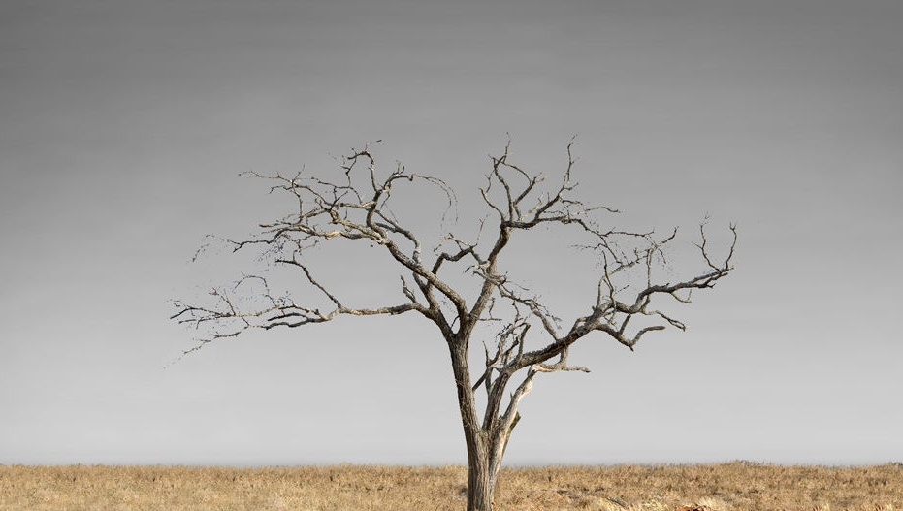
Let’s explore the issue of poverty…
Click each icon to learn more
After exploring all issues, click here to ‘dig deeper’

Slide 6
Hunger
821 million
people do not have enough food to eat.
Tawonga helps prepare a family meal. (Malawi) Photo: Pilirani Chimombo
Notes:
Malawi. Tawonga helps prepare a family meal. For most of her life, her parents have struggled to put meals on the table. Tawonga often had to miss school because she was too sick from hunger. Her family now grows enough food to provide three meals a day, ending the struggle of malnutrition.
Photo credit: Pilirani Chimombo
Source: http://www.fao.org/3/I9553EN/i9553en.pdf

Slide 7
Economics
689 million
or 1 in 10 people around the world live in extreme poverty on less than $1.90 per day.
Sakun selling food near the local school. (India) Photo: Caritas India
Notes:
Sakun lives with her sister in a village in a rural area of Chhattisgarh, India’s poorest state. A member of the Gond tribal community, she developed polio as a child and relies on crutches to move around.
Before the coronavirus pandemic reached India, your support through Project Compassion 2020, helped Sakun to access disability support, train in business development and set up her own kiosk, selling food near the local school. She even saved enough money to construct a more permanent stall.
Photo credit: Caritas India
Now, the school – and Sakun’s shop - is closed due to COVID-19.
Source: https://www.un.org/sustainabledevelopment/poverty/

Slide 8
Water Access
2.2 billion
people do not have access to safely managed drinking water.
Zimbabwe Integrated Community Development Program and Putting Children First Program. Photo: Caritas Australia
Notes:
Zimbabwe Integrated Community Development Program and Putting Children First Program
Photo credit: Ivy Khoury
*Safely managed drinking water and sanitation services: Drinking water from sources located on premises, free from contamination and available when needed, and using hygienic toilets from which wastes are treated and disposed of safely.
Source: https://www.who.int/news/item/18-06-2019-1-in-3-people-globally-do-not-have-access-to-safe-drinking-water-unicef-who

Slide 9
Age
One half
of the world’s poor are children.
Salma spends quality time with her children. (Bangladesh). Photo: Ashish Peter Gomes
Notes:
Salma spends quality time with her newborn baby boy and her daughter in Bangladesh. They tell stories and play games. Photo credit: Ashish Peter Gomes
Source: https://www.undp.org/press-releases/half-worlds-poor-are-children

Slide 10
Sanitation
2 billion
people do not have access to a decent toilet.
Halima shows her daughter how to wash her hands correctly outside their shelter in a Rohingya refugee camp in Bangladesh. Photo: Caritas Bangladesh
Notes:
Halima shows her daughter how to wash her hands correctly outside their shelter in a Rohingya refugee camp in Bangladesh. Photo credit: Caritas Bangladesh
Source: https://www.un.org/sustainabledevelopment/water-and-sanitation/

Slide 11
Education
59 million
primary-school-aged children do not go to school.
Marvelous, Primary School Headmaster, is seen teaching students in Zimbabwe. Photo: Richard Wainwright
Notes:
Marvelous, Primary School Headmaster is seen teaching students in Zimbabwe. Photo credit: Richard Wainwright, Caritas Australia
Source: http://uis.unesco.org/en/topic/out-school-children-and-youth

Slide 12
Let’s dig deeper to find some of the root causes of poverty…

Slide 13
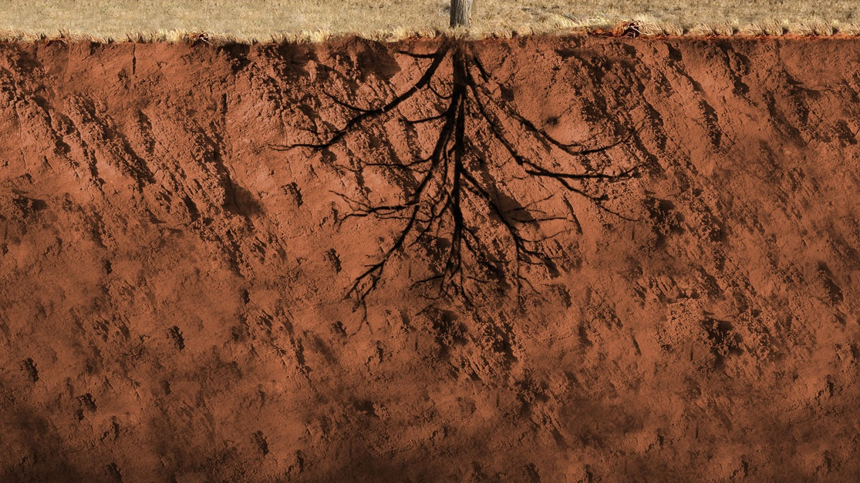
Click each icon to learn more
DEBT
FOOD INSECURITY
CONFLICT
ENVIRONMENTAL FACTORS
LACK OF EDUCATION
POOR HEALTH
GENDER INEQUALITY
FINISH

Slide 14
DEBT
Countries borrow money to pay for projects like roads, irrigation and agricultural projects, or to help them through difficult times such as a natural disaster.
Debt mounts up and repayments can eat into budgets for education, health and development programs. This can mean prices for essential services increase, making it harder for some people to afford them.
Notes:
Source:
CAFOD https://cafod.org.uk/content/download/887/6906/version/4/file/Factsheet%20Poverty%202018.pdf

Slide 15
Conflict
During conflict, family income earners may be called into military service, crops may be destroyed, water sources polluted, and livestock killed or stolen. This reduces family income for essential services, food security and water access.
Injury and disability, resulting from the conflict, can make it difficult for people to grow food, collect water or earn an income – even after a conflict stops.
Notes:
Source:
CAFOD https://cafod.org.uk/content/download/887/6906/version/4/file/Factsheet%20Poverty%202018.pdf

Slide 16
Lack of Education
Education is an essential route out of poverty. Children who cannot go to school will have fewer opportunities to escape poverty.
Contributing factors to lack of education include:
Lack of government funding
Cost of school supplies, uniforms and transportation
Untrained or poorly trained teachers
No classroom
Gender
Disabilities
Distance from home to school.
A 2017 study conducted by UNESCO says that if all adults received two more years of schooling or completed secondary school, it would lift nearly 60 million people out of poverty.
Notes:
Source:
CAFOD https://cafod.org.uk/content/download/887/6906/version/4/file/Factsheet%20Poverty%202018.pdf
Global Citizen https://www.globalcitizen.org/en/content/10-barriers-to-education-around-the-world-2/
https://www.globalcitizen.org/en/content/poverty-education-satistics-facts/
UNESCO https://www.unaa.org.au/2017/06/28/unesco-study-reveals-correlation-between-poverty-and-education/#:~:text=According%20to%20the%20study%2C%20if,million%20people%20out%20of%20poverty.&text=Universal%20access%20to%20primary%20and,therefore%2C%20decrease%20the%20poverty%20rate.

Slide 17
Gender Inequities
Women and girls are more vulnerable to poverty than men and boys. Their basic rights are denied just because of their gender.
This means they often have less access to basic education and healthcare, have less opportunities to find jobs, are paid lower wages, suffer harm and, in some countries, can’t even own their own land.
Notes:
Source:
CAFOD https://cafod.org.uk/content/download/887/6906/version/4/file/Factsheet%20Poverty%202018.pdf
UN Women https://www.unwomen.org/en/about-us/about-un-women

Slide 18
Health
Poor health is a major cause of poverty. Seeking medical attention can be expensive. Doctors' visits, tests, medicines and transportation all need to be paid for.
Family income earners may have to take time off work or children may have to take time off school to care for the sick. Some families may need to sell belongings or go into debt to pay for medical costs.
For the first time in 20 years extreme poverty rates have risen as a result of the COVID-19 pandemic.
Notes:
Source:
World Bank https://www.worldbank.org/en/topic/health/brief/poverty-health
https://www.worldbank.org/en/topic/poverty/overview

Slide 19
Environmental factors
It is estimated that climate change will drive between 68 and 132 million people into poverty by 2030.
Natural disasters, food insecurity, impacts of deforestation (cutting down forests) and loss of biodiversity (variety of plants and animals) are all contributing factors.
These environmental factors will affect poorest countries the most.
Notes:
Source:
World Bank https://www.worldbank.org/en/topic/poverty/overview
https://www.worldbank.org/en/topic/climatechange/overview

Slide 20
Food Insecurity
Without access to safe, sufficient and nutritious food, people’s health can suffer. This can affect their ability to earn an income, attend school and lead a healthy and active life.
Children who are not able to eat properly for long periods of time may have incomplete physical development and can have learning difficulties.
Notes:
Source:
CAFOD https://cafod.org.uk/content/download/887/6906/version/4/file/Factsheet%20Poverty%202018.pdf
FAO http://www.fao.org/3/y4671e/y4671e06.htm#fnB31

Slide 21
Caritas Australia education resources
Primary Poverty resources:
Poverty PowerPoint
Poverty in Our World – Primary Lessons
Poverty Prayer Service
For other Caritas Australia resources, please visit https://www.caritas.org.au/resources/school-resources/
We would love to hear from you! To send feedback, enquiries or comments, please email us as education@caritas.org.au
Stay up to date with events and resources!
Teachers - Subscribe to Caritas Australia’s Education e-newsletter
This resource was last updated April 2021.

Slide 22
Thank you

