Slide 1
How to use this resource
This resource is intended as a source of information for teaching and learning about issues surrounding poverty across several curriculum areas and units. The points raised will be explored further in the teaching resources found at the end of these slides.
Please refer to the ‘Notes’ section of this presentation for additional information and source references.
It is our hope that you will take part/all of these slides and use them in a way that best suits your purposes. If you do edit this presentation, please ensure content and photos from this resources remain with the appropriate credit to Caritas Australia and the photographers.
Note: This PowerPoint is editable so you can adapt it to your needs. If you do edit this resource, please ensure content and photos remain with the appropriate credit to Caritas Australia and the photographers.
Copyright Policy: Material within our resources come from a variety of sources and authors, including Caritas Australia staff volunteers, overseas partners and news organisations. These resources and the information, names, images, pictures, logos are provided “as is”, without warranty. Any mistakes brought to the attention of Caritas Australia will be corrected as soon as possible. To review the full Caritas Australia Copyright Policy, please visit: Caritas Australia​

Slide 2
Curriculum links
RELIGIOUS EDUCATION
While there are many different Religious Education Curricula around the country, it is not surprising that there are many common themes. Here are the common themes in this resource.
Living the mission of Jesus
Catholic Social Teachings: Human Dignity, Preferential Option for the Poor, Solidarity, Subsidiarity and Participation, Care for our Common Home and the Common Good.
Initiation and belonging. (Year 7 & 8)
Action for justice and peace. (Year 9 & 10)
ECONOMICS AND BUSINESS
Economics and Business aims to ensure students develop understandings that will enable them to actively and ethically participate in the local, national, regional and global economy as economically, financially and business-literate citizens.
GEOGRAPHY
Geography aims to ensure that students develop as informed, responsible and active citizens who can contribute to the development of an environmentally and economically sustainable, and socially just world.
CIVICS AND CITIZENSHIP
Civics and Citizenship aims to ensure students develop the capacities and dispositions to participate in the civic life of their nation at a local, regional and global level and as individuals in a globalised world.
MATHEMATICS
Mathematics aims to ensure that students are confident, creative users and communicators of mathematics, able to investigate, represent and interpret situations in their personal and work lives and as active citizens.

Slide 3
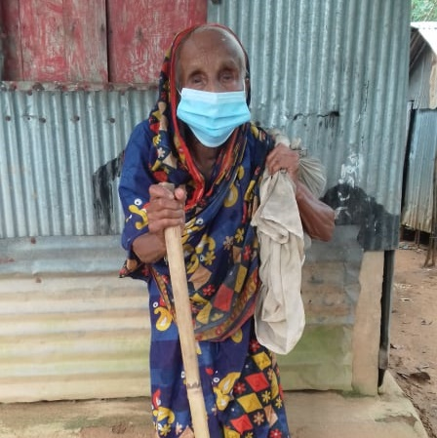
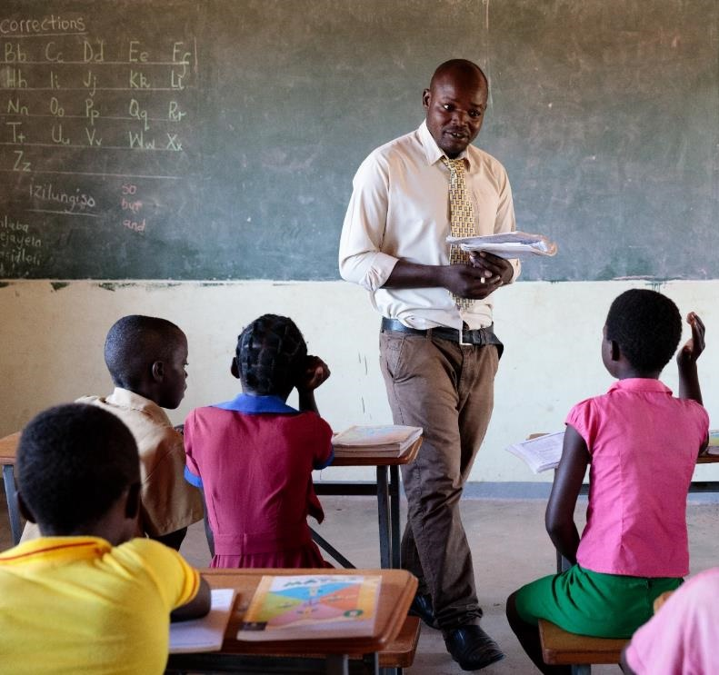
Root Causes of Poverty
Notes:
Photo credits (left to right)
Salma spends quality time with her children. They tell stories and play games. Photo credit: Ashish Peter Gomes
Afiron is 100 years old and live near Bangladesh’s border with India. Her late husband, Kalu, was a day labourer, she has no children and now that he has gone, she lives on her own on a rubber plantation on government forest land. Photo credit: Caritas Australia
Marvelous, Primary School Headmaster teaching students in Zimbabwe. Photo credit: Richard Wainwright, Caritas Australia

Slide 4
What does poverty look like?
Poverty is hunger.
Poverty is lack of shelter.
Poverty is being sick and not being able to see a doctor.
Poverty is not being able to go to a school, not knowing how to read, not being able to speak properly.
Poverty is not having a job, is fear for the future, living one day at a time.
Poverty is losing a child to illness brought about by lack of clean water.
Poverty is powerlessness, lack of representation and freedom.
Adapted from Can Anyone Hear Us?: Voices of the Poor (World Bank Publication) Paperback – March 1, 2000
By Deepa Narayan, Raj Patel, Kai Schafft, Anne Rademacher and Sara Koch-Schulte
Notes:
Source:
Adapted from Can Anyone Hear Us?: Voices of the Poor (World Bank Publication) Paperback – March 1, 2000
By Deepa Narayan, Raj Patel, Kai Schafft, Anne Rademacher and Sara Koch-Schulte

Slide 5
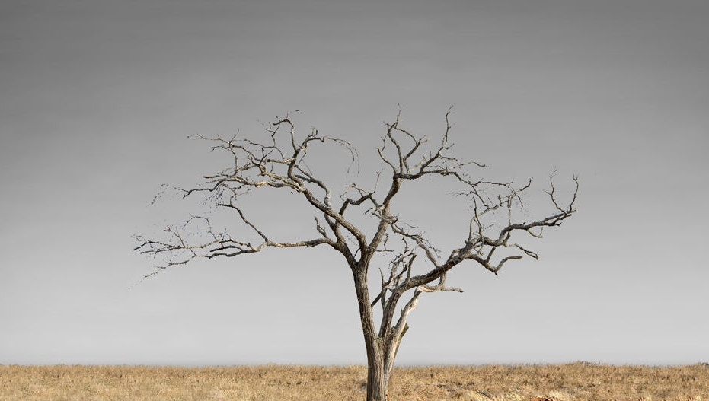
Let’s explore the issue of poverty…
Click each icon to learn more
After exploring all issues, click here to ‘dig deeper’

Slide 6
Hunger
821 million
people do not have enough food to eat.
Photo credit: Pilirani Chimombo
Notes:
Tawonga helps prepare a family meal. For most of her life, her parents have struggled to put meals on the table. Tawonga often had to miss school because she was too sick from hunger. Her family now grows enough food to provide three meals a day, ending the struggle of malnutrition.
Photo credit: Pilirani Chimombo
Source: http://www.fao.org/3/I9553EN/i9553en.pdf

Slide 7
Economics
689 million
or 1 in 10 people around the world live in extreme poverty on less than $1.90 per day.
Photo credit: Caritas India
Notes:
Thirty-two-year-old Sakun lives with her sister in a village in a rural area of Chhattisgarh, India’s poorest state. A member of the Gond tribal community, she developed polio as a child and relies on crutches to move around.
Before the coronavirus pandemic reached India, your support through Project Compassion 2020, helped Sakun to access disability support, train in business development and set up her own kiosk, selling food near the local school. She even saved enough money to construct a more permanent stall.
Photo credit: Caritas India
Now, the school – and Sakun’s shop - is closed due to COVID-19 and she can’t access nourishing food.
Source: https://www.un.org/sustainabledevelopment/poverty/

Slide 8
Water Access
2.2 billion
people do not have access to safely managed drinking water.
Photo credit: Ivy Khoury
Notes:
Zimbabwe Integrated Community Development Program and Putting Children First Program
Photo credit: Ivy Khoury
*Safely managed drinking water and sanitation services: Drinking water from sources located on premises, free from contamination and available when needed, and using hygienic toilets from which wastes are treated and disposed of safely.
Source: https://www.who.int/news/item/18-06-2019-1-in-3-people-globally-do-not-have-access-to-safe-drinking-water-unicef-who

Slide 9
Age
One half
of the world’s poor are children.
Photo credit: Ashish Peter Gomes
Notes:
Salma spends quality time with her newborn baby boy Samiul and her daughter Maya. They tell stories and play games. Photo credit: Ashish Peter Gomes
Source: https://www.undp.org/press-releases/half-worlds-poor-are-children

Slide 10
Sanitation
2 billion
people do not have access to a decent toilet.
Photo credit: Caritas Bangladesh
Notes:
Halima shows her daughter how to wash her hands correctly outside their shelter in a Rohingya refugee camp. Photo credit: Caritas Bangladesh
Source: https://www.un.org/sustainabledevelopment/water-and-sanitation/

Slide 11
Education
59 million
primary-school-aged children do not go to school.
Photo credit: Richard Wainwright
Notes:
Marvelous, Primary School Headmaster teaching students in Zimbabwe. Photo credit: Richard Wainwright, Caritas Australia
Source: http://uis.unesco.org/en/topic/out-school-children-and-youth

Slide 12
Let’s dig deeper to find some of the root causes of poverty…

Slide 13
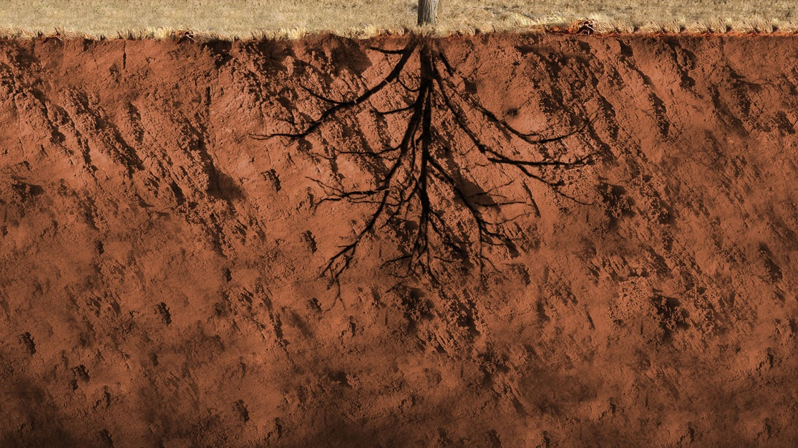
Click each icon to learn more
DEBT
FOOD INSECURITY
CONFLICT
ENVIRONMENTAL FACTORS
LACK OF EDUCATION
POOR HEALTH
GENDER INEQUALITY
FINISH

Slide 14
DEBT
Some countries have to borrow money to fund infrastructure for their communities, or to help them through difficult times such as a natural disaster.
Money may be used inappropriately (corruption) or mismanaged. Debt mounts up and repayments can consume budgets for education, health and development. Thus, creating greater strain on the existing services and driving up costs for local communities.
Notes:
Source:
CAFOD https://cafod.org.uk/content/download/887/6906/version/4/file/Factsheet%20Poverty%202018.pdf

Slide 15
Conflict
During conflict, family income earners may be called into military service, crops may be destroyed, water sources polluted, and livestock killed or stolen. This reduces family income for essential services, food security and water access.
Injury and disability, resulting from the conflict, can make it difficult for people to grow food, collect water or earn an income – even after a conflict subsides.
Notes:
Source:
CAFOD https://cafod.org.uk/content/download/887/6906/version/4/file/Factsheet%20Poverty%202018.pdf

Slide 16
Lack of Education
Education is an essential route out of poverty. Children who cannot go to school will have fewer opportunities to escape poverty.
Lack of education is a major predictor to passing poverty from one generation to the next. Contributing factors to lack of education include:
Lack of government funding
Cost of education – supplies, uniforms and transportation
Untrained or poorly trained teachers
No classroom
Gender
Disabilities
Distance from home to school.
A 2017 study conducted by UNESCO states that if all adults received two more years of schooling or completed secondary school, it would lift nearly 60 million people out of poverty.
Notes:
Source:
CAFOD https://cafod.org.uk/content/download/887/6906/version/4/file/Factsheet%20Poverty%202018.pdf
Global Citizen https://www.globalcitizen.org/en/content/10-barriers-to-education-around-the-world-2/
https://www.globalcitizen.org/en/content/poverty-education-satistics-facts/
UNESCO https://www.unaa.org.au/2017/06/28/unesco-study-reveals-correlation-between-poverty-and-education/#:~:text=According%20to%20the%20study%2C%20if,million%20people%20out%20of%20poverty.&text=Universal%20access%20to%20primary%20and,therefore%2C%20decrease%20the%20poverty%20rate.

Slide 17
Gender Inequities
Women and girls are more vulnerable to poverty than men and boys. Their basic rights are denied just because of their gender.
This means they often have less access to basic education and healthcare, lack opportunities for decent work, have lower wages, suffer violence and, in some countries, can’t even own their own land.
They are underrepresented in decision-making positions in the home, local communities and on a national scale.
Empowering women fuels thriving economies, spurs productivity and growth.
Notes:
Source:
CAFOD https://cafod.org.uk/content/download/887/6906/version/4/file/Factsheet%20Poverty%202018.pdf
UN Women https://www.unwomen.org/en/about-us/about-un-women

Slide 18
Health
A major cause of poverty is ill health. Medical attention can be expensive, factors such as consultations, tests, medicines and transportation all need to be taken into account.
Income loss can occur when those earning an income need to care for the sick. Some families may need to sell assets or go into debt to pay for medical expenses. Education can be disrupted for some children who are required to take care of sick relatives.
COVID-19 is the newest and most immediate threat to poverty reduction. There are major economic implications for communities around the world. For the first time in 20 years extreme poverty rates have risen as a result of the pandemic.
Notes:
Source:
World Bank https://www.worldbank.org/en/topic/health/brief/poverty-health
https://www.worldbank.org/en/topic/poverty/overview

Slide 19
Environmental factors
It is estimated that climate change will drive between 68 and 132 million people into poverty by 2030.
Natural disasters, food insecurity, impacts of deforestation and loss of biodiversity are all contributing factors. Each of these factors alone need to be addressed in order to create positive change.
These environmental factors are affecting poorest countries the most.
Notes:
Source:
World Bank https://www.worldbank.org/en/topic/poverty/overview
https://www.worldbank.org/en/topic/climatechange/overview

Slide 20
Food Insecurity
Without access to safe, sufficient and nutritious food supplies, people’s health can suffer, affecting their ability to earn an income, attend school and lead and maintain a healthy and active life.
Food insecurity can be a result of:
Environmental factors such as rising sea levels, natural disasters or rising temperatures
Economic and political causes such as unfair trade rules, economic cycles, political and civil insecurity, lack of access to farming land or land grabbing.
Notes:
Source:
CAFOD https://cafod.org.uk/content/download/887/6906/version/4/file/Factsheet%20Poverty%202018.pdf
FAO http://www.fao.org/3/y4671e/y4671e06.htm#fnB31

Slide 21
Caritas Australia education resources
Primary Poverty resources:
Poverty PowerPoint - Secondary
Poverty in Our World – Secondary Lessons
Poverty Prayer Service
For more Caritas Australia resources visit our website: caritas.org.au/resources/school-resources/
We would love to hear from you! To send feedback, enquiries or comments, please email us as education@caritas.org.au
Stay up to date with events and resources!
Teachers - Subscribe to Caritas Australia’s Education e-newsletter
This resource was last updated April 2021.

Slide 22
Thank you

